Slide 1

Noida Institute of Engineering and Technology, Greater Noida
Relational Data Model and Language
Unit: 2
DBMS
Sana Anjum
Assistant Professor
CSE Department
ACSE0506
Course Details (B Tech 5th Sem)

Slide 2

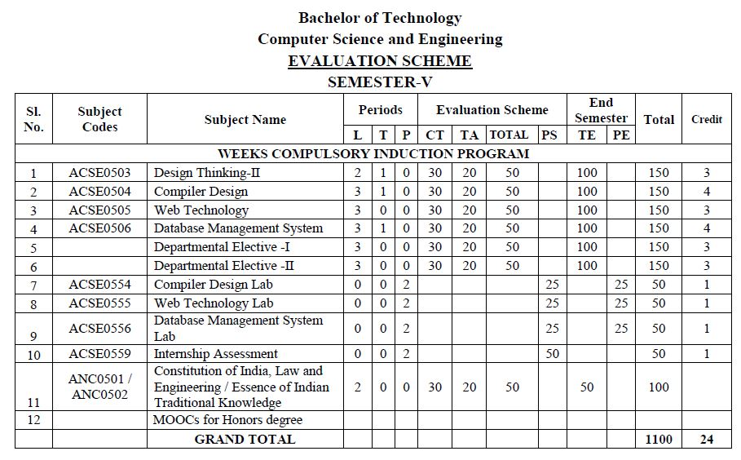
Evaluation Scheme

Slide 3
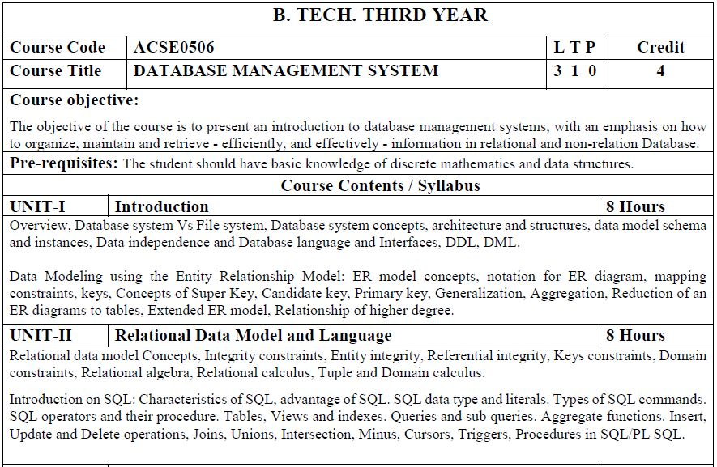
Syllabus

Slide 4
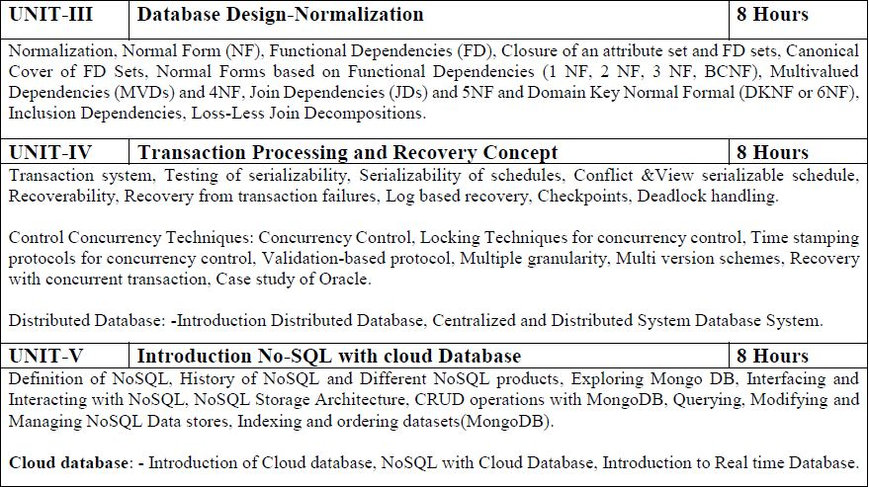
Syllabus

Slide 5
Syllabus of Unit 2
Relational data Model and Language: Relational data model concepts, integrity constraints, entity integrity, referential integrity, Keys constraints, Domain constraints, relational algebra, relational calculus, tuple and domain calculus.
Introduction on SQL: Characteristics of SQL, advantage of SQL. SQl data type and literals. Types of SQL commands. SQL operators and their procedure. Tables, views and indexes. Queries and sub queries. Aggregate functions. Insert, update and delete operations, Joins, Unions, Intersection, Minus, Cursors, Triggers, Procedures in SQL/PL SQL.

Slide 6
Branch wise Applications
Railway Reservation System
Library Management System
Banking
Education Sector
Credit card exchanges
Social Media Sites
Broadcast communications
Account
Online Shopping
Human Resource Management
Manufacturing
Airline Reservation System
Healthcare

Slide 7

Course Objectives
Present an introduction to database management systems, with an emphasis on how to organize, maintain and retrieve - efficiently, and effectively - information from a DBMS.
Differentiate between database system and file system.
Knowledge of the different models like database modeling, relational, hierarchical and network models.
Explain basic issues of transaction processing and concurrency control.

Slide 8
Course Outcomes
At the end of semester students will be able
CO1 | Analyse database used to solve real world and complex problem and design the ER, EER model
CO2 | Analyse and apply structured Query Language (SQL) or procedural Query Language (PL/SQL) to solve the complex queries. Implement relational model, integrity constraints.
CO3 | Design and implement database for storing , managing data efficiently by applying the Normalization process on the database.
CO4 | Synthesize the concepts of transaction management, concurrency control and recovery
CO5 | Understand and implement the concepts NOSQL with cloud database

Slide 9
Program Outcomes (POs)
Engineering Graduates will be able to:
1. Engineering knowledge: Apply the knowledge of mathematics, science, engineering fundamentals, and an engineering specialization to the solution of complex engineering problems.
2. Problem analysis: Identify, formulate, review research literature, and analyze complex engineering problems reaching substantiated conclusions using first principles of mathematics, natural sciences, and engineering sciences.
3. Design/development of solutions: Design solutions for complex engineering problems and design system components or processes that meet the specified needs with appropriate consideration for the public health and safety, and the cultural, societal, and environmental considerations.
4. Conduct investigations of complex problems: Use research-based knowledge and research methods including design of experiments, analysis and interpretation of data, and synthesis of the information to provide valid conclusions.

Slide 10
Program Outcomes (POs)
Contd..
5. Modern tool usage: Create, select, and apply appropriate techniques, resources, and modern engineering and IT tools including prediction and modeling to complex engineering activities with an understanding of the limitations.
6. The engineer and society: Apply reasoning informed by the contextual knowledge to assess societal, health, safety, legal and cultural issues and the consequent responsibilities relevant to the professional engineering practice.
7. Environment and sustainability: Understand the impact of the professional engineering solutions in societal and environmental contexts, and demonstrate the knowledge of, and need for sustainable development.
8. Ethics: Apply ethical principles and commit to professional ethics and responsibilities and norms of the engineering practice.

Slide 11
Program Outcomes (POs)
Contd..
9. Individual and team work: Function effectively as an individual, and as a member or leader in diverse teams, and in multidisciplinary settings.
10. Communication: Communicate effectively on complex engineering activities with the engineering community and with society at large, such as, being able to comprehend and write effective reports and design documentation, make effective presentations, and give and receive clear instructions.
11. Project management and finance: Demonstrate knowledge and understanding of the engineering and management principles and apply these to one’s own work, as a member and leader in a team, to manage projects and in multidisciplinary environments.
12. Life-long learning: Recognize the need for, and have the preparation and ability to engage in independent and life-long learning in the broadest context of technological change.

Slide 12
CO-PO Mapping
co-po correlation matrix
co.k | po1 | po2 | po3 | po4 | po5 | po6 | po7 | po8 | po9 | po10 | po11 | po12
ACSE0506.1 | 2 | 2 | 3 | 2 | 3 | 3 | - | 1 | - | 2 | 2 | 3
ACSE0506.2 | 2 | 2 | 2 | 2 | 2 | 2 | - | 1 | - | 1 | 2 | 2
ACSE0506.3 | 2 | 2 | 3 | 2 | 3 | 2 | - | 2 | - | 1 | 2 | 3
ACSE0506.4 | 3 | 3 | 3 | 3 | 3 | 2 | - | 2 | - | 2 | 1 | 3
ACSE0506.5 | 3 | 2 | 2 | 2 | 3 | 2 | - | 2 | 1 | 3 | 3 | 3
Average | 2.4 | 2.2 | 2.6 | 2.2 | 2.8 | 2.2 | - | 1.6 | 1 | 1.8 | 2 | 2.8

Slide 13
Program Specific Outcomes
On successful completion of graduation degree the Computer Science & Engineering graduates will be able to:
PSO1: | Work as a software developer, database administrator, tester or networking engineer for providing solutions to the real world and industrial problems. ​
PSO2: | Apply core subjects of information technology related to data structure and algorithm, software engineering, web technology, operating system, database and networking to solve complex IT problems. ​
PSO3: | Practice multi-disciplinary and modern computing techniques by lifelong learning to establish innovative career.
PSO4: | Work in a team or individual to manage projects with ethical concern to be a successful employee or employer in IT industry.

Slide 14
CO-PSO Mapping
 | Program Specific Outcomes
 | PSO1 | PSO2 | PSO3 | PSO4
ACSE0506.1 | 3 | 1 | 3 | 1
ACSE0506.2 | 3 | 1 | 3 | 1
ACSE0506.3 | 3 | 1 | 3 | 1
ACSE0506.4 | 3 | 1 | 3 | 1
ACSE0506.5 | 3 | 1 | 3 | 1
AVG | 3.00 | 1.00 | 3.00 | 1.00

Slide 15
Program Educational Objectives (PEOs)
PEO1:Apply sound knowledge in the field of information technology to fulfill the needs of IT industry.
PEO2:Design innovative and interdisciplinary systems through latest digital technologies.
PEO3:Inculcate professional – social ethics, team work and leadership for serving the society.
PEO4:Inculcate lifelong learning in the field of computing for successful career in organizations and R&D sectors.

Slide 16
Result Analysis
Subject Result: 100%
Faculty Result: 100%

Slide 17
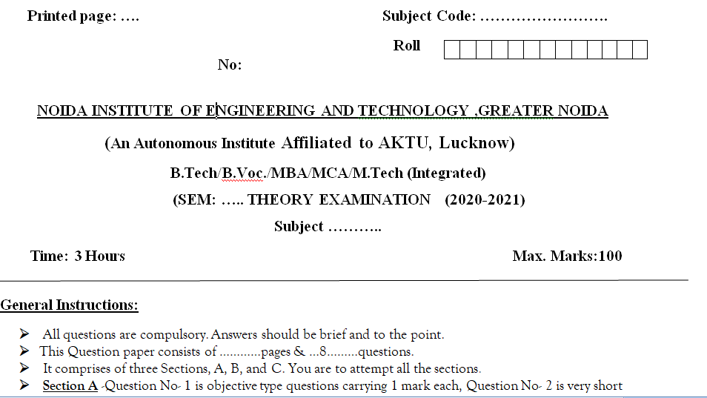
End Semester Question Paper Template

Slide 18
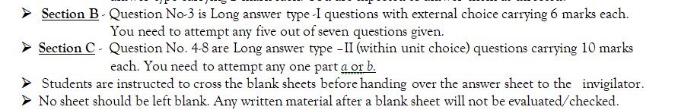
End Semester Question Paper Template

Slide 19

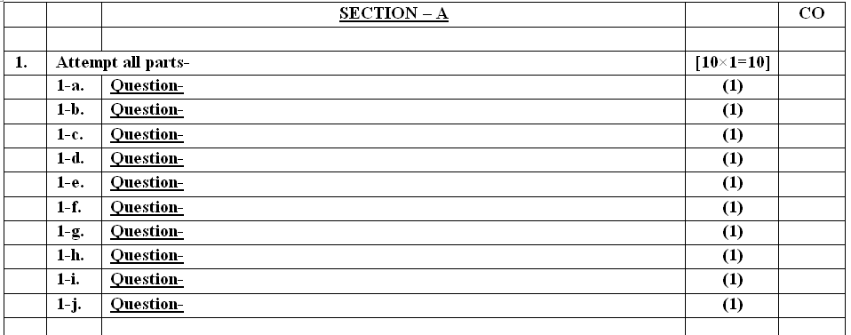
End Semester Question Paper Template

Slide 20
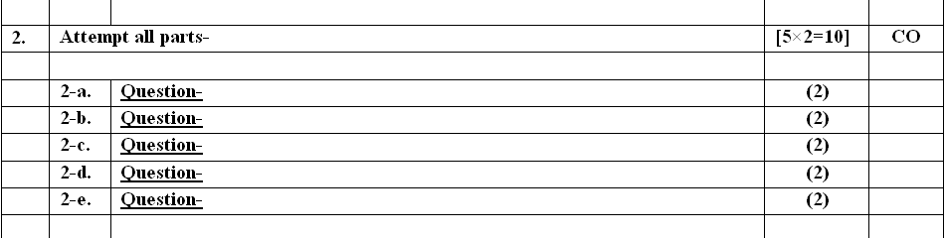
End Semester Question Paper Template

Slide 21
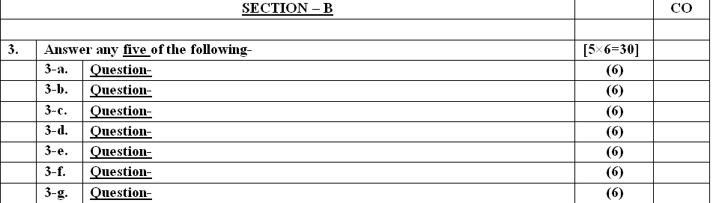
End Semester Question Paper Template

Slide 22
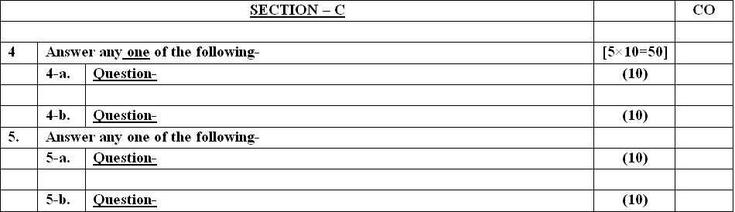
End Semester Question Paper Template

Slide 23
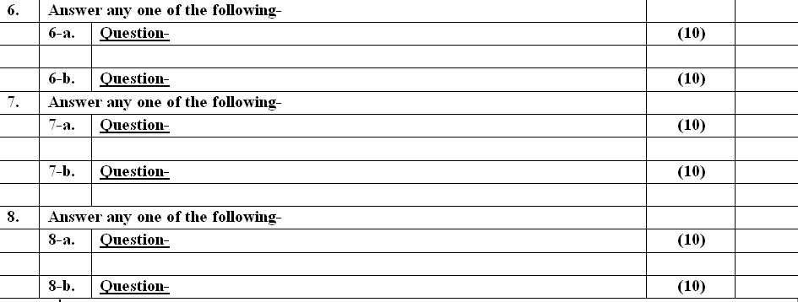
End Semester Question Paper Template

Slide 24
Prerequisite and Recap
A good background in DBMS fundamentals is required.
Students should be comfortable with the relational model.
Students should also be capable of implementing a large, complex system on UNIX in C or C++.
The proper understanding of data structures and algorithms will help you to understand the DBMS quickly.
Recap
In last unit we studied about
Data base and file system
Database concept and architecture
Database languages
ER modeling concepts

Slide 25
Brief Introduction about Subject
A database management system (DBMS) refers to the technology for creating and managing databases. DBMS is a software tool to organize (create, retrieve, update, and manage) data in a database.
The main aim of a DBMS is to supply a way to store up and retrieve database information that is both convenient and efficient. By data, we mean known facts that can be recorded and that have embedded meaning.
Usually, people use software such as DBASE IV or V, Microsoft ACCESS, or EXCEL to store data in the form of a database.
A datum is a unit of data. Meaningful data combined to form information. Hence, information is interpreted data - data provided with semantics. MS. ACCESS is one of the most common examples of database management software.

Slide 26
Brief Introduction about Subject
Video Links:
https://www.youtube.com/watch?v=kBdlM6hNDAE&list=PLxCzCOWd7aiFAN6I8CuViBuCdJgiOkT2Y
https://www.youtube.com/watch?v=3EJlovevfcA&list=PLxCzCOWd7aiFAN6I8CuViBuCdJgiOkT2Y&index=2

Slide 27
Contents
Unit-2
Relational Data Model Concepts
Integrity Constraints
Entity Integrity
Referential Integrity
Keys Constraints
Domain Constraints
Relational Algebra
Relational Calculus
Tuple and Domain Calculus
Introduction on SQL
Characteristics of SQL
Advantages of SQL

Slide 28
Contents (Conti….)
SQL data type and literals
Types of SQL Commands
SQL operators and their Procedures
Tables, Views and Indexes
Queries and subqueries
Aggregate Functions
Insert Update and Delete Operations
Joins
Unions
Minus
Cursors
Triggers
Procedures in SQL/PL SQL

Slide 29
Unit Objectives
Students will be able to learn various Relational Data Model Concepts, constraints, Relational Algebra and Relational Calculus
Introduction on SQL and Various queries and operations in SQL which helps to communicate with the database. Along with cursors, Triggers and Procedures in SQL/PL SQL.

Slide 30
Topic 1 Objectives
1. Relational Data Model in DBMS
Relational Data Model Concepts
Properties of Relations
Constraints in Relational Model
Domain Constraints
Entity Integrity Constraints
Referential Integrity Constraints
Key Constraints

Slide 31
1.Relational Data Model in DBMS
Relational Model was proposed by E.F. Codd to model data in the form of relations or tables. After designing the conceptual model of Database using ER diagram, we need to convert the conceptual model in the relational model which can be implemented using any RDBMS languages like Oracle SQL, MySQL etc.
What is Relational Model?
Relational Model represents how data is stored in Relational Databases. A relational database stores data in the form of relations (tables). Consider a relation STUDENT with attributes ROLL_NO, NAME, ADDRESS, PHONE and AGE shown in Table 1.

Slide 32
Relational Data Model in DBMS (conti..)
ROLL_NO | NAME | ADDRESS | PHONE | AGE
1 | John | DELHI | 9999999999 | 18
2 | Elisa | GURGAON | 9898989898 | 18
3 | William | Noida | 9717171798 | 20
4 | Ryan | DELHI | 8512545896 | 18

Slide 33
1.1Relational Data Model Concepts
Attribute: Attributes are the properties that define a relation. e.g.; ROLL_NO, NAME
Relation Schema: A relation schema represents name of the relation with its attributes. e.g.; STUDENT (ROLL_NO, NAME, ADDRESS, PHONE and AGE) is relation schema for STUDENT. If a schema has more than 1 relation, it is called Relational Schema.
Tuple: Each row in the relation is known as tuple. The above relation contains 4 tuples.
Relation Instance: The set of tuples of a relation at a particular instance of time is called as relation instance. Table 1 shows the relation instance of STUDENT at a particular time. It can change whenever there is insertion, deletion or updation in the database.
1 | RAM | DELHI | 9455123451 | 18

Slide 34
Relational Data Model Concepts (conti..)
Degree: The number of attributes in the relation is known as degree of the relation. The STUDENT relation defined above has degree 5.
Cardinality: The number of tuples in a relation is known as cardinality. The STUDENT relation defined above has cardinality 4.
Column: Column represents the set of values for a particular attribute.
Relation key - Every row has one, two or multiple attributes, which is called relation key.
Attribute domain – Every attribute has some pre-defined value and scope which is known as attribute domain.
NULL Values: The value which is not known or unavailable is called NULL value. It is represented by blank space.
Relation State: Relational state of database is a union of all the individual relation states, whenever the database is changed a new state arise. Relational state is also Cartesian product of degree n on domain.

Slide 35
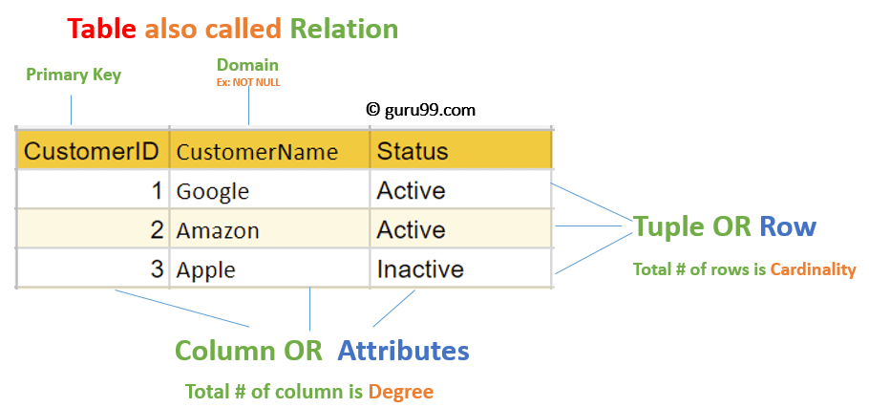
Relational Model Concepts(conti…)
Note: number of attributes in a relational schema is also referred as its Arity.

Slide 36
Codd’s rules
Dr Edgar F. Codd, after his extensive research on the Relational Model of database systems, came up with twelve rules of his own, which according to him, a database must obey in order to be regarded as a true relational database.
These rules can be applied on any database system that manages stored data using only its relational capabilities. This is a foundation rule, which acts as a base for all the other rules.
Rule 1: Information Rule
The data stored in a database, may it be user data or metadata, must be a value of some table cell. Everything in a database must be stored in a table format.
Rule 2: Guaranteed Access Rule
Every single data element (value) is guaranteed to be accessible logically with a combination of table-name, primary-key (row value), and attribute-name (column value). No other means, such as pointers, can be used to access data.

Slide 37
Codd’s rules (Cont.)
Rule 3: Systematic Treatment of NULL Values
The NULL values in a database must be given a systematic and uniform treatment. This is a very important rule because a NULL can be interpreted as one the following − data is missing, data is not known, or data is not applicable.
Rule 4: Active Online Catalog
The structure description of the entire database must be stored in an online catalog, known as data dictionary, which can be accessed by authorized users. Users can use the same query language to access the catalog which they use to access the database itself.
Rule 5: Comprehensive Data Sub-Language Rule
A database can only be accessed using a language having linear syntax that supports data definition, data manipulation, and transaction management operations. This language can be used directly or by means of some application. If the database allows access to data without any help of this language, then it is considered as a violation.

Slide 38
Codd’s rules (Cont.)
Rule 6: View Updating Rule
All the views of a database, which can theoretically be updated, must also be updatable by the system.
Rule 7: High-Level Insert, Update, and Delete Rule
A database must support high-level insertion, updation, and deletion. This must not be limited to a single row, that is, it must also support union, intersection and minus operations to yield sets of data records.
Rule 8: Physical Data Independence
The data stored in a database must be independent of the applications that access the database. Any change in the physical structure of a database must not have any impact on how the data is being accessed by external applications.
Rule 9: Logical Data Independence
The logical data in a database must be independent of its user’s view (application). Any change in logical data must not affect the applications using it. For example, if two tables are merged or one is split into two different tables, there should be no impact or change on the user application. This is one of the most difficult rule to apply.

Slide 39
Codd’s rules (Cont.)
Rule 10: Integrity Independence
A database must be independent of the application that uses it. All its integrity constraints can be independently modified without the need of any change in the application. This rule makes a database independent of the front-end application and its interface.
Rule 11: Distribution Independence
The end-user must not be able to see that the data is distributed over various locations. Users should always get the impression that the data is located at one site only. This rule has been regarded as the foundation of distributed database systems.
Rule 12: Non-Subversion Rule
If a system has an interface that provides access to low-level records, then the interface must not be able to subvert the system and bypass security and integrity constraints.

Slide 40
1.2 Properties of Relations
Name of the relation is distinct from all other relations.
Each value in a tuple is an atomic value; that is, it is not divisible into components within the framework of the basic relational model. Hence, composite and multivalued attributes are not allowed. This model is sometimes called the flat relational model.
Hence, multivalued attributes must be represented by separate relations, and composite attributes are represented only by their simple component attributes in the basic relational model.
Each attribute contains a distinct name.
Attribute domain has no significance.
Tuple has no duplicate value.
Order of tuple can have a different sequence.

Slide 41
1.3 Constraints in Relational Model
An important concept is that of NULL values, which are used to represent the values of attributes that may be unknown or may not apply to a tuple. A special value, called NULL, is used in these cases.
Constraints In Relational Model:
While designing Relational Model, we define some conditions which must hold for data present in database are called Constraints.
These constraints are checked before performing any operation (insertion, deletion and updation) in database.
If there is a violation in any of constrains, operation will fail.

Slide 42
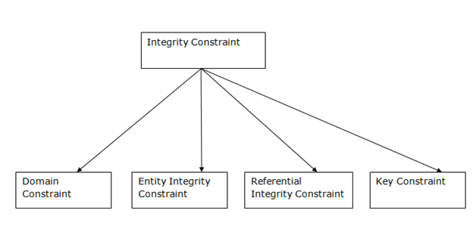
Types of Integrity Constraints

Slide 43
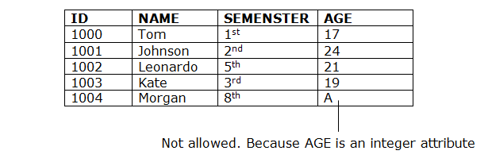
Domain constraints
Domain constraints can be defined as the definition of a valid set of values for an attribute.
The data type of domain includes string, character, integer, time, date, currency, etc. The value of the attribute must be available in the corresponding domain.

Slide 44
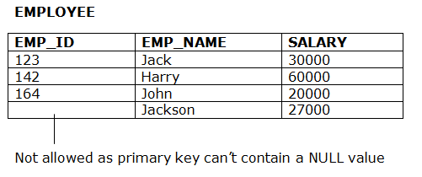
Entity integrity constraints
The entity integrity constraint states that primary key value can't be null.
This is because the primary key value is used to identify individual rows in relation and if the primary key has a null value, then we can't identify those rows.
A table can contain a null value other than the primary key field.

Slide 45
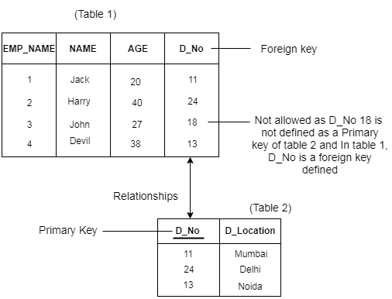
Referential Integrity Constraints
A referential integrity constraint is specified between two tables.
In the Referential integrity constraints, if a foreign key in Table 1 refers to the Primary Key of Table 2, then every value of the Foreign Key in Table 1 must be null or be available in Table 2.

Slide 46
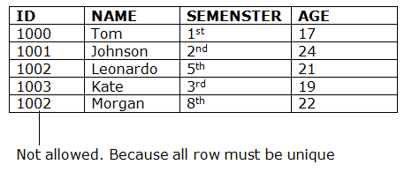
Key constraints
Keys are the entity set that is used to identify an entity within its entity set uniquely.
An entity set can have multiple keys, but out of which one key will be the primary key. A primary key can contain a unique and null value in the relational table.

Slide 47
Weekly Assignment 1.1
Define Relational Algebra.
Differentiate between Relational Algebra and Relational Calculus.
How study of Relational Algebra related with DBMS?
Consider the following relational database schema consisting of the four relation schemas:
passenger ( pid, pname, pgender, pcity)
agency ( aid, aname, acity)
flight (fid, fdate, time, src, dest)
booking (pid, aid, fid, fdate)
Answer the following questions using relational algebra queries;
Get the details about all flights from Chennai to New Delhi.
Get the details of flights that are scheduled on both dates 01/12/2020 and 02/12/2020 at 16:00 hours.
Find the passenger names for passengers who have bookings on at least one flight.

Slide 48
Contents
Relational Algebra
Basic of Relational Database
Relational Algebra
Importance of Relational Algebra
Relational Query Language and their types
Relational Algebra Operations

Slide 49
Topic 2 Objectives
To learn about basic of Relational Database
To know about Relational Algebra
Importance of Relational Algebra
To learn about Relational Query Languages
Relational Algebra operations
as it provides theoretical foundation for relational databases, particularly query languages for such databases, chief among which is SQL.
3. To learn about Relational Calculus

Slide 50
2.1 Basic of Relational Database
Once we have database ready users will start using them.
But how will they access the database? Most of the time they access the data by using some applications.
These applications will communicate to database by SQL and DBMS is responsible for managing the application and SQL intact.
SQL has its own querying methods to interact with database. But how these queries work in the database?
These queries work similar to relational algebra that we have in mathematics.
Note :- Relational algebra mainly provides theoretical foundation for relational databases and SQL.

Slide 51
2.2 Relational Algebra
The basic set of operations for the relational model is known as the relational algebra. These operations enable a user to specify
basic retrieval requests.
Working of relational Algebra
The result of a retrieval is a new relation, which may have been formed from one or more relations. The algebra operations thus produce new relations, which can be further manipulated using operations of the same algebra.
A sequence of relational algebra operations forms a relational algebra expression, whose result will also be a relation that represents the result of a database query (or retrieval request).

Slide 52
2.2.1 Importance of Relational Algebra
Importance of relational Algebra
It provides a formal foundation for relational model operations.
It is used as a basis for implementing and optimizing queries in the query processing and optimization modules that are integral parts of relational database management systems (RDBMSs)
Some of its concepts are incorporated into the SQL . The Relational Algebra and Relational Calculus query language for RDBMSs.
Although most commercial RDBMSs in use today do not provide user interfaces for relational algebra queries, the core operations and functions in the internal modules of most relational systems are based on relational algebra operations.

Slide 53
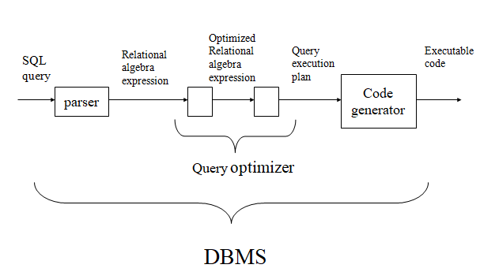
2.2.2 Query processing

Slide 54
Relational Query Languages
Relational query languages use relational algebra to break the user requests and instruct the DBMS to execute the requests. It is the language by which user communicates with the database.
These relational query languages can be:
Procedural Query Language
Non- Procedural Query Language

Slide 55
Relational Query Languages(Conti…)
Procedural Query Language
In procedural query language, user instructs the system to perform a series of operations to produce the desired results.
Here users tells what data to be retrieved from database and how to retrieve it. Relational algebra is a procedural query language.

Slide 56
Relational Query Languages(conti…)
2. Non- Procedural Query Language
In Non-procedural query language, user instructs the system to produce the desired result without telling the step by step process. Here users tells what data to be retrieved from database but doesn’t tell how to retrieve it.
Relational Calculus is Non- Procedural Query Language.
Example :-
If you are just telling him to make a tea and not telling the process then it is a non-procedural language, however if you are telling the step by step process like switch on the stove, boil the water, add milk etc. then it is a procedural language.

Slide 57
Relational Query Languages(conti…)
Conti………….
Note :- I have used word conceptual while describing relational algebra and relational calculus, because they are theoretical mathematical system or query language, they are not the practical implementation, SQL is a practical implementation of relational algebra and relational calculus.

Slide 58
Relational Algebra
Relational algebra is a procedural query language.
It gives a step by step process to obtain the result of the query.
It takes Relation as input and generate relation as output. Relational algebra mainly provides theoretical foundation for relational databases and SQL.
It uses operators to perform queries. An operator can be either unary or binary.
No duplication is allowed.

Slide 59
2.2.3 Relational Algebra Operations
Basic/Fundamental Operator
SELECT(σ)
Projection(π)
Rename (ρ)
Union operation (υ)
Set Difference (-)
Cartesian product(X)
Derived operator
Intersection
Join Operations
Inner Join:
Theta Join:
EQUI join:
NATURAL JOIN (⋈)
OUTER JOIN
Left Outer Join
Right Outer Join
Full Outer Join

Slide 60
Basic SQL Relational Algebra Operations
Relational Algebra divided in various groups
Unary Relational Operations
SELECT (symbol: σ)
PROJECT (symbol: π)
RENAME (symbol: ρ)
Relational Algebra Operations From Set Theory
UNION (υ)
INTERSECTION ( ),
DIFFERENCE (-)
CARTESIAN PRODUCT ( x )
Binary Relational Operations
JOIN
DIVISION

Slide 61
SELECT (σ)
The SELECT operation is used for selecting a subset of the tuples according to a given selection condition. Sigma(σ)Symbol denotes it. It is used as an expression to choose tuples which meet the selection condition. Select operator selects tuples that satisfy a given predicate.
Notation: σ_{p}(r)
where:
σ is the predicate
r stands for relation which is the name of the table
p is prepositional logic

Slide 62
SELECT (σ) Examples
Example 1:
σ _{topic} = "Database" (Subject)
Output – Selects tuples from Subject where topic = ‘Database’.
Example 2
σ _{topic} = "Database" and author = “Codd"( Subject)
Output – Selects tuples from Subject where the topic is ‘Database’ and ‘author’ is Codd.
Example 3
σ _{sales} > 50000 (Customers)
Output – Selects tuples from Customers where sales is greater than 50000

Slide 63
Projection(π)
The projection eliminates all attributes of the input relation but those mentioned in the projection list. The projection method defines a relation that contains a vertical subset of Relation.
This helps to extract the values of specified attributes to eliminates duplicate values. (pi) ∏ symbol is used to choose attributes from a relation. This operator helps you to keep specific columns from a relation and discards the other columns.
Notation: ∏ A1, A2, An (r)
A1, A2, A3 is used as an attribute name of relation r.

Slide 64
Example of Projection
Consider the following table
Here, the projection of CustomerName and status will give
Π _{CustomerName, Status} (Customers)
CustomerID | CustomerName | Status
1 | Google | Active
2 | Amazon | Active
3 | Apple | Inactive
4 | Alibaba | Active
CustomerName | Status
Google | Active
Amazon | Active
Apple | Inactive
Alibaba | Active

Slide 65
Rename (ρ)
Rename is a unary operation used for renaming attributes of a relation.
‘Rename' operation is denoted with small Greek letter rho ρ.
ρ (a/b)R will rename the attribute ‘b’ of relation by ‘a’.

Slide 66
Union operation (υ)
UNION is symbolized by ∪ symbol. It includes all tuples that are either in R or S or both in R & S.It also eliminates duplicate tuples. So, set A UNION set B would be expressed as:
A ∪ B.
For a union operation to be valid, the following conditions must hold :
R and S must be the same number of attributes.
Attribute domains need to be compatible.
Duplicate tuples should be automatically removed.

Slide 67

Example of Union
Consider the following tables.
A ∪ B gives
Table A |  |  | Table B
column 1 | column 2 |  | column 1 | column 2
1 | 1 |  | 1 | 1
1 | 2 |  | 1 | 3
column 1 | column 2
1 | 1
1 | 2
1 | 3

Slide 68
Set Difference (-)
The result of set difference operation is tuples, which are present in one relation but are not in the second relation. – Symbol denotes it.
The result of A – B, is a relation which includes all tuples that are in A but not in B.
Notation : r − s
Finds all the tuples that are present in r but not in s.
The attribute name of A has to match with the attribute name in B.
The two-operand relations A and B should be either compatible or Union compatible.
It should be defined relation consisting of the tuples that are in relation A, but not in B.

Slide 69
Set Difference (-) Example
Table A |  |  | Table B
column 1 | column 2 |  | column 1 | column 2
1 | 1 |  | 1 | 1
1 | 2 |  | 1 | 3
Example: A-B
Table A – B
column 1 | column 2
1 | 2

Slide 70
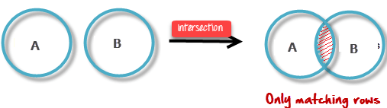
Intersection
An intersection is defined by the symbol ∩
Notation : A ∩ B
Defines a relation consisting of a set of all tuple that are in both A and B. However, A and B must be union-compatible.

Slide 71
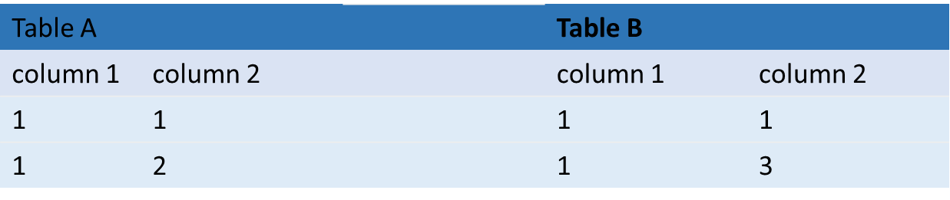
Intersection Example
Example: A ∩ B
Table A ∩ B
column 1 | column 2
1 | 1

Slide 72
Cartesian Product(X) in DBMS
Cartesian Product in DBMS is an operation used to merge columns from two relations. Generally, a cartesian product is never a meaningful operation when it performs alone. However, it becomes meaningful when it is followed by other operations. It is also called Cross Product or Cross Join.
σ _{column 2} = _{‘1’} (A X B)
Output – The above example shows all rows from relation A and B whose column 2 has value 1
σ column 2 = ‘1’ (A X B)
column 1 | column 2
1 | 1
1 | 1

Slide 73
Cartesian Product(X) Example
Consider R1 table −
Table R2
RegNo | Branch | Section
1 | CSE | A
2 | ECE | B
3 | CIVIL | A
4 | IT | B
Name | RegNo
Bhanu | 2
Priya | 4

Slide 74
Cartesian Product(X) Example
R1 X R2
RegNo | Branch | Section | Name | RegNo
1 | CSE | A | Bhanu | 2
1 | CSE | A | Priya | 4
2 | ECE | B | Bhanu | 2
2 | ECE | B | Priya | 4
3 | CIVIL | A | Bhanu | 2
3 | CIVIL | A | Priya | 4
4 | IT | B | Bhanu | 2
4 | IT | B | Priya | 4

Slide 75
Join Operations
Join operation is essentially a cartesian product followed by a selection criterion.
Join operation denoted by ⋈.
JOIN operation also allows joining variously related tuples from different relations.
Types of JOIN: Various forms of join operation are:
Inner Joins:
Theta join
EQUI join
Natural join
Outer join:
Left Outer Join
Right Outer Join
Full Outer Join

Slide 76
Join Operations
Various forms of join operation
JOIN (Inner Join) : Return rows when there is at least one match in both tables
LEFT JOIN(Left Outer Join): Return all rows from the left table, even if there are no matches in the right table
RIGHT JOIN(Right Outer Join): Return all rows from the right table, even if there are no matches in the left table
FULL JOIN: Return rows when there is a match in one of the tables

Slide 77
Inner Join (Theta Join)
In an inner join, only those tuples that satisfy the matching criteria are included, while the rest are excluded. Let’s study various types of Inner Joins:
Theta Join:
The general case of JOIN operation is called a Theta join. It is denoted by symbol θ
Example:- A ⋈_{θ} B
Theta join can use any conditions in the selection criteria.
For example:- A ⋈ _{A.column 2 > B.column 2} (B)
A ⋈ A.column 2 > B.column 2 (B)
column 1 | column 2
1 | 2

Slide 78
Inner Join ( Equi Join)
EQUI join:
When a theta join uses only equivalence condition, it becomes a equi join.
For example:- A ⋈ _{A.column 2 = B.column 2} (B)
A ⋈ A.column 2 = B.column 2 (B)
column 1 | column 2
1 | 1

Slide 79
Inner Join- Natural Join (⋈)
NATURAL JOIN:
Natural Join does not utilize any of the comparison operators. In this type of join, the attributes should have the same name and domain.
In Natural Join, there should be at least one common attribute between two relations.
It performs selection forming equality on those attributes which appear in both relations and eliminates the duplicate attributes.

Slide 80
Natural Join Example
Consider the following two tables
C ⋈ D
C |  | D
Num | Square | Num | Cube
2 | 4 | 2 | 8
3 | 9 | 3 | 27
C ⋈ D
Num | Square | Cube
2 | 4 | 8
3 | 9 | 27

Slide 81
Outer Join
Outer Join:
An OUTER JOIN doesn’t require each record in the two join tables to have a matching record. In this type of join, the table retains each record even if no other matching record exists.
Three types of Outer Joins are:
Left Outer Join
Right Outer Join
Full Outer Join

Slide 82
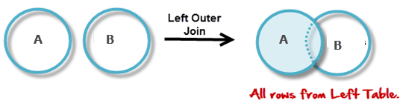
Left Outer Join (A B)
LEFT outer Join:
LEFT JOIN returns all the rows from the table on the left even if no matching rows have been found in the table on the right. When no matching record found in the table on the right, NULL is returned.

Slide 83
Left Outer Join Example
Consider the following 2 Tables
A
Num | Square
2 | 4
3 | 9
4 | 16
B
Num | Cube
2 | 8
3 | 27
5 | 125

Slide 84
Left Outer Join Example
(A B)
(A B)
Num | Square | Cube
2 | 4 | 8
3 | 9 | 27
4 | 16 | –

Slide 85
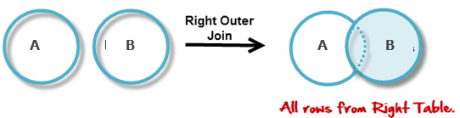
Right Outer Join (A B)
Right outer join:
RIGHT JOIN returns all the columns from the table on the right even if no matching rows have been found in the table on the left. Where no matches have been found in the table on the left, NULL is returned. RIGHT outer JOIN is the opposite of LEFT JOIN

Slide 86
Right Outer Join Example
(A B)
(A B)
Num | Cube | Square
2 | 8 | 4
3 | 27 | 9
5 | 125 | –

Slide 87
Full Outer Join (A B)
In a FULL OUTER JOIN , all tuples from both relations are included in the result, irrespective of the matching condition.
Example:
A B
Num | Square | Cube
2 | 4 | 8
3 | 9 | 27
4 | 16 | –
5 | – | 125

Slide 88
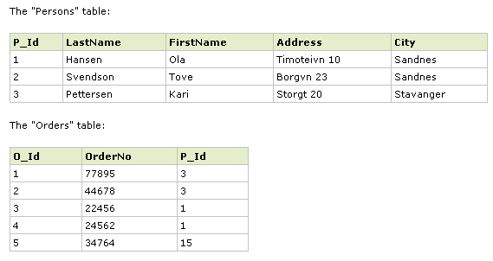
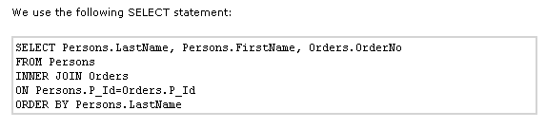
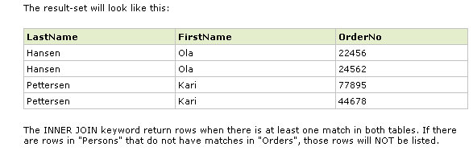
Inner Join

Slide 89
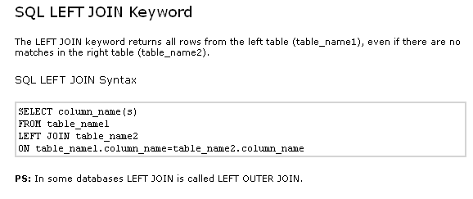
Left Join

Slide 90
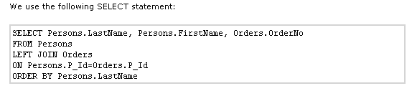
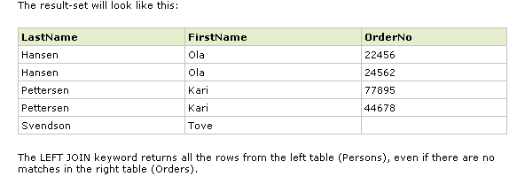
Example: Left Join

Slide 91
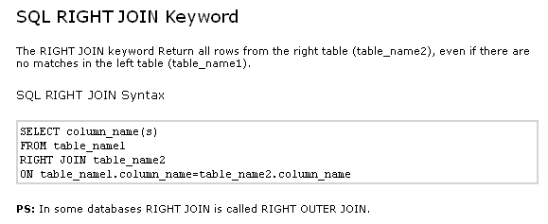
Right Join

Slide 92
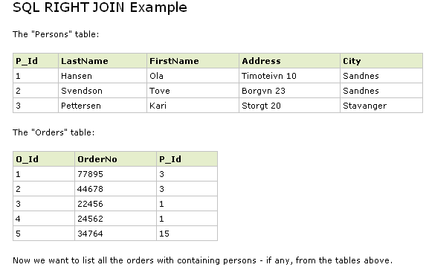
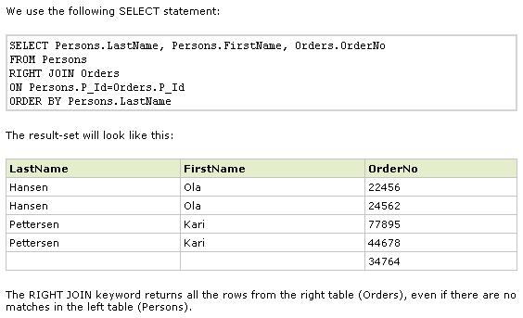
Example: Right Join

Slide 93
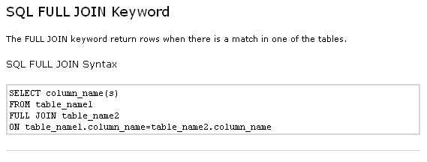
Full Join

Slide 94
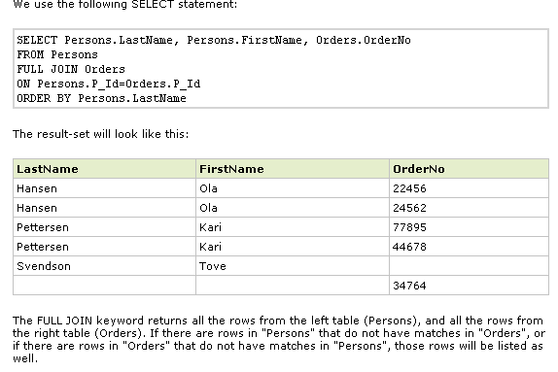
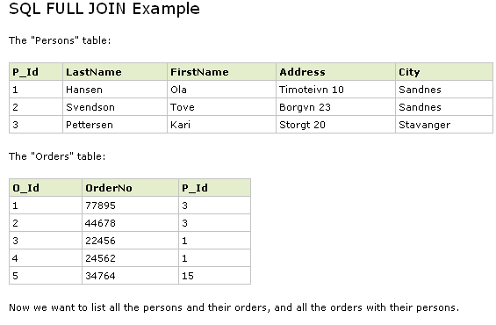
Example: Full Join

Slide 95
2.4 Relational Calculus
In contrast to Relational Algebra, Relational Calculus is a non-procedural query language, that is, it tells what to do but never explains how to do it.
Relational calculus exists in two forms −
Tuple Relational Calculus (TRC)
Filtering variable ranges over tuples
Notation : {T | Condition}
Returns all tuples T that satisfies a condition.
For example −
{ T.name | Author(T) AND T.article = 'database' }
Output − Returns tuples with 'name' from Author who has written article on 'database'.

Slide 96
2.4.1 Tuple Relational Calculus (TRC)
TRC can be quantified. We can use Existential (∃) and Universal Quantifiers (∀).
For example −
{ R| ∃T ∈ Authors(T.article='database' AND R.name=T.name)}
Output − The above query will yield the same result as the previous one.

Slide 97
2.4.2 Domain Relational Calculus (DRC)
Domain Relational Calculus (DRC)
In DRC, the filtering variable uses the domain of attributes instead of entire tuple values (as done in TRC, mentioned above).
Notation : { a1, a2, a3, ..., an | P (a1, a2, a3, ... ,an)}
Where a1, a2 are attributes and P stands for formulae built by inner attributes.

Slide 98
Domain Relational Calculus (DRC)
For example −{< article, page, subject > | ∈ TutorialsPoint ∧ subject = 'database'}
Output − Yields Article, Page, and Subject from the relation TutorialsPoint, where subject is database.
Just like TRC, DRC can also be written using existential and universal quantifiers. DRC also involves relational operators.
The expression power of Tuple Relation Calculus and Domain Relation Calculus is equivalent to Relational Algebra.

Slide 99
Introduction on SQL
Content
SQL Introduction
Characteristics of SQL
Advantages of SQL
SQL Data Types and Literals
Type of SQL Commands
SQL Operators and their Procedure
Tables, VIEWS and Indexes
Queries and Subqueries

Slide 100
Topic 3 Objective
Introduction on SQL and Various queries and operations in SQL which helps to communicate with the database. Along with cursors, Triggers and Procedures in SQL/PL SQL.

Slide 101
3.1 SQL Introduction
SQL
SQL stands for Structured Query Language. It is used for storing and managing data in relational database management system (RDMS).
It is a standard language for Relational Database System. It enables a user to create, read, update and delete relational databases and tables.
All the RDBMS like MySQL, Informix, Oracle, MS Access and SQL Server use SQL as their standard database language.
SQL allows users to query the database in a number of ways, using English-like statements.

Slide 102
3.2 Rules
Rules:
SQL follows the following rules:
Structure query language is not case sensitive. Generally, keywords of SQL are written in uppercase.
Statements of SQL are dependent on text lines. We can use a single SQL statement on one or multiple text line.
Using the SQL statements, you can perform most of the actions in a database.
SQL depends on tuple relational calculus and relational algebra.

Slide 103
3.4 Characteristics of SQL
SQL is easy to learn.
SQL is used to access data from relational database management systems.
SQL can execute queries against the database.
SQL is used to describe the data.
SQL is used to define the data in the database and manipulate it when needed.
SQL is used to create and drop the database and table.
SQL is used to create a view, stored procedure, function in a database.
SQL allows users to set permissions on tables, procedures, and views.

Slide 104
3.5 Advantages of SQL
There are the following advantages of SQL:
High speed
Using the SQL queries, the user can quickly and efficiently retrieve a large amount of records from a database.
No coding needed
In the standard SQL, it is very easy to manage the database system. It doesn't require a substantial amount of code to manage the database system.
Well defined standards
Long established are used by the SQL databases that are being used by ISO and ANSI.

Slide 105
Advantages of SQL(conti…)
Portability
SQL can be used in laptop, PCs, server and even some mobile phones.
Interactive language
SQL is a domain language used to communicate with the database. It is also used to receive answers to the complex questions in seconds.
Multiple data view
Using the SQL language, the users can make different views of the database structure.

Slide 106
3.6 SQL Data Types
SQL String Data Type
char(n) | It is a fixed width character string data type. Its size can be up to 8000 characters.
varchar(n) | It is a variable width character string data type. Its size can be up to 8000 characters.
varchar(max) | It is a variable width character string data types. Its size can be up to 1,073,741,824 characters.
text | It is a variable width character string data type. Its size can be up to 2GB of text data.
nchar | It is a fixed width Unicode string data type. Its size can be up to 4000 characters.
nvarchar | It is a variable width Unicode string data type. Its size can be up to 4000 characters.
ntext | It is a variable width Unicode string data type. Its size can be up to 2GB of text data.
binary(n) | It is a fixed width Binary string data type. Its size can be up to 8000 bytes.
varbinary | It is a variable width Binary string data type. Its size can be up to 8000 bytes.
image | It is also a variable width Binary string data type. Its size can be up to 2GB.

Slide 107
3.6.1 Numeric Data Types
SQL Server Numeric Data Types
bit | It is an integer that can be 0, 1 or null.
tinyint | It allows whole numbers from 0 to 255.
Smallint | It allows whole numbers between -32,768 and 32,767.
Int | It allows whole numbers between -2,147,483,648 and 2,147,483,647.
bigint | It allows whole numbers between -9,223,372,036,854,775,808 and 9,223,372,036,854,775,807.
float(n) | It is used to specify floating precision number data from -1.79E+308 to 1.79E+308. The n parameter indicates whether the field should hold the 4 or 8 bytes. Default value of n is 53.
real | It is a floating precision number data from -3.40E+38 to 3.40E+38.
money | It is used to specify monetary data from -922,337,233,685,477.5808 to 922,337,203,685,477.5807.

Slide 108
3.6.2 Date and Time Data Type
SQL Date and Time Data Type
datetime | It is used to specify date and time combination. It supports range from January 1, 1753, to December 31, 9999 with an accuracy of 3.33 milliseconds.
datetime2 | It is used to specify date and time combination. It supports range from January 1, 0001 to December 31, 9999 with an accuracy of 100 nanoseconds
date | It is used to store date only. It supports range from January 1, 0001 to December 31, 9999
time | It stores time only to an accuracy of 100 nanoseconds
timestamp | It stores a unique number when a new row gets created or modified. The time stamp value is based upon an internal clock and does not correspond to real time. Each table may contain only one-time stamp variable.

Slide 109
3.6.3 Other Data Types
SQL Other Data Types
Sql_variant | It is used for various data types except for text, timestamp, and ntext. It stores up to 8000 bytes of data.
XML | It stores XML formatted data. Maximum 2GB.
cursor | It stores a reference to a cursor used for database operations.
table | It stores result set for later processing.
uniqueidentifier | It stores GUID (Globally unique identifier).

Slide 110

3.7 SQL Literals(1)
There are four kinds of literal values supported in SQL. They are :Character string, Bit string, Exact numeric, and Approximate numeric. These are explained as following below.
1.Character strings:-
Character strings are written as a sequence of characters enveloped in single quotes. the only quote character is delineate at intervals a personality string by 2 single quotes. Some example of character strings are :
‘My String’
‘I love Data Science’
‘16378’

Slide 111
SQL Literals(2)
2. Bit String:
A bit string is written either as a sequence of 0s and 1s enveloped in single quotes and preceded by the letter ‘B’ or as a sequence of positional representation system digits enveloped in single quotes and preceded by the letter X’ some examples are given below :
B’10001011′
B’1′
B’0′
X’C 5′
X’0′

Slide 112
SQL Literals(3)
3. Exact Numeric:
These literals are written as a signed or unsigned decimal variety probably with mathematical notation. Samples of actual numeric literals are given below :
8
80
80.00
0.8
+88.88
-88.88

Slide 113
SQL Literals(4)
4. Approximate numeric : Approximate numeric literals are written as actual numeric literals followed by the letter ‘E’, followed by a signed or unsigned number. Some example are :
6E6
66.6E6
+66E-6
0.66E
-6.66E-8

Slide 114
3.8 SQL Commands
Structured Query Language(SQL) as we all know is the database language by the use of which we can perform certain operations on the existing database. We can also use this language to create a database. SQL uses certain commands like Create, Drop, Insert, etc. to carry out the required tasks.
These SQL commands are mainly categorized into four categories as:
DDL – Data Definition Language
DQL – Data Query Language
DML – Data Manipulation Language
DCL – Data Control Language

Slide 115
SQL Commands(DDL)
DDL: Data Definition Language
This includes changes to the structure of the table like creation of table, altering table, deleting a table etc.
All DDL commands are auto-committed. That means it saves all the changes permanently in the database.
List of DDL commands:
CREATE: This command is used to create the database or its objects (like table, index, function, views, store procedure, and triggers).
DROP: This command is used to delete objects from the database.
ALTER: This is used to alter the structure of the database.
TRUNCATE: This is used to remove all records from a table, including all spaces allocated for the records are removed.

Slide 116
SQL Commands(DQL)
COMMENT: This is used to add comments to the data dictionary.
RENAME: This is used to rename an object existing in the database.
DQL (Data Query Language):
DQL statements are used for performing queries on the data within schema objects. The purpose of the DQL Command is to get some schema relation based on the query passed to it. We can define DQL as follows it is a component of SQL statement that allows getting data from the database and imposing order upon it. It includes the SELECT statement. This command allows getting the data out of the database to perform operations with it. When a SELECT is fired against a table or tables the result is compiled into a further temporary table, which is displayed or perhaps received by the program i.e. a front-end.
SELECT: It is used to retrieve data from the database.

Slide 117
SQL Commands(DDL)
DML: Data Manipulation Language
DML commands are used for manipulating the data stored in the table and not the table itself.
DML commands are not auto-committed. It means changes are not permanent to database, they can be rolled back.
List of DML commands:
INSERT : It is used to insert data into a table.
UPDATE: It is used to update existing data within a table.
DELETE : It is used to delete records from a database table.
LOCK: Table control concurrency.
CALL: Call a PL/SQL or JAVA subprogram.
EXPLAIN PLAN: It describes the access path to data.

Slide 118
SQL Commands(DCL)
DCL: Data Control Language
DCL includes commands such as GRANT and REVOKE which mainly deal with the rights, permissions, and other controls of the database system.
List of DCL commands:
GRANT: This command gives users access privileges to the database.
REVOKE: This command withdraws the user’s access privileges given by using the GRANT command.

Slide 119
SQL Commands(TCL)
TCL: Transaction Control Language
These commands are to keep a check on other commands and their affect on the database. These commands can annul changes made by other commands by rolling the data back to its original state. It can also make any temporary change permanent.
List of TCL commands:
COMMIT: to permanently save
ROLLBACK: to undo change in case of any error occurs.
SAVEPOINT: Sets a save point within a transaction.
SET TRANSACTION: Specify characteristics for the transaction.

Slide 120
3.9 SQL Operators and their Procedures
SQL Operators
Every database administrator and user uses SQL queries for manipulating and accessing the data of database tables and views.
The manipulation and retrieving of the data are performed with the help of reserved words and characters, which are used to perform arithmetic operations, logical operations, comparison operations, compound operations, etc.
What is SQL Operator?
The SQL reserved words and characters are called operators, which are used with a WHERE clause in a SQL query. In SQL, an operator can either be a unary or binary operator. The unary operator uses only one operand for performing the unary operation, whereas the binary operator uses two operands for performing the binary operation.

Slide 121
SQL Operators and their Procedures(conti…)
Syntax of Unary SQL Operator
29. Operator SQL_Operand
8Mello Java Program for Beginners
Syntax of Unary SQL Operator
Operand1 SQL_Operator Operand2
Note: SQL operators are used for filtering the table's data by a specific condition in the SQL statement

Slide 122
SQL Operators and their Procedures(conti…)
Types of Operator:
SQL operators are categorized in the following categories:
SQL Arithmetic Operators
SQL Comparison Operators
SQL Logical Operators
SQL Set Operators
SQL Bit-wise Operators
SQL Unary Operators

Slide 123
SQL Operators and their Procedures(conti…)
SQL Arithmetic Operators
The Arithmetic Operators perform the mathematical operation on the numerical data of the SQL tables. These operators perform addition, subtraction, multiplication, and division operations on the numerical operands.
Following are the various arithmetic operators performed on the SQL data:
SQL Addition Operator (+)
SQL Subtraction Operator (-)
SQL Multiplication Operator (+)
SQL Division Operator (-)
SQL Modulus Operator (+)

Slide 124
SQL Operators and their Procedures(conti…)
SQL Addition Operator (+)
The Addition Operator in SQL performs the addition on the numerical data of the database table. In SQL, we can easily add the numerical values of two columns of the same table by specifying both the column names as the first and second operand. We can also add the numbers to the existing numbers of the specific column.
Syntax of SQL Addition Operator:
SELECT operand1 + operand2;

Slide 125
SQL Operators and their Procedures(conti…)
This example consists of an Employee_details table, which has four columns Emp_Id, Emp_Name, Emp_Salary, and Emp_Monthlybonus.
Suppose, we want to add 20,000 to the salary of each employee specified in the table. Then, we have to write the following query in the SQL:
Emp Id | Emp Name | Emp Salary | Emp Monthlybonus
101 | Tushar | 25000 | 4000
102 | Anuj | 30000 | 200

Slide 126
SQL Operators and their Procedures(conti…)
SELECT Emp_Salary + 20000 as Emp_New_Salary FROM Employee_details;
In this query, we have performed the SQL addition operation on the single column of the given table.
Suppose, we want to add the Salary and monthly bonus columns of the above table, then we have to write the following query in SQL:
SELECT Emp_Salary + Emp_Monthlybonus as Emp_Total_Salary FROM Employee_details;
In this query, we have added two columns with each other of the above table.

Slide 127

SQL Operators and their Procedures(conti…)
SQL Subtraction Operator (-)
The Subtraction Operator in SQL performs the subtraction on the numerical data of the database table. In SQL, we can easily subtract the numerical values of two columns of the same table by specifying both the column names as the first and second operand. We can also subtract the number from the existing number of the specific table column.
Syntax of SQL Subtraction Operator:
SELECT operand1 - operand2;

Slide 128

SQL Operators and their Procedures(conti…)
Suppose we want to subtract 5,000 from the salary of each employee given in the Employee_details table. Then, we have to write the following query in the SQL:
SELECT Emp_Salary - 5000 as Emp_New_Salary FROM Employee_details;
In this query, we have performed the SQL subtraction operation on the single column of the given table.
If we want to subtract the penalty from the salary of each employee, then we have to write the following query in SQL:
SELECT Emp_Salary - Penalty as Emp_Total_Salary FROM Employee_details;

Slide 129

SQL Operators and their Procedures(conti…)
SQL Multiplication Operator (*)
The Multiplication Operator in SQL performs the Multiplication on the numerical data of the database table. In SQL, we can easily multiply the numerical values of two columns of the same table by specifying both the column names as the first and second operand.
Syntax of SQL Multiplication Operator:
SELECT operand1 * operand2;

Slide 130

SQL Operators and their Procedures(conti…)
Suppose, we want to double the salary of each employee given in the Employee_details table. Then, we have to write the following query in the SQL:
SELECT Emp_Salary * 2 as Emp_New_Salary FROM Employee_details;
In this query, we have performed the SQL multiplication operation on the single column of the given table.
If we want to multiply the Emp_Id column to Emp_Salary column of that employee whose Emp_Id is 202, then we have to write the following query in SQL:
SELECT Emp_Id * Emp_Salary as Emp_Id * Emp_Salary FROM Employee_details WHERE Emp_Id = 202;
In this query, we have multiplied the values of two columns by using the WHERE clause.

Slide 131
SQL Operators and their Procedures(conti…)
SQL Division Operator (/)
The Division Operator in SQL divides the operand on the left side by the operand on the right side.
Syntax of SQL Division Operator:
SELECT operand1 / operand2;
In SQL, we can also divide the numerical values of one column by another column of the same table by specifying both column names as the first and second operand.
We can also perform the division operation on the stored numbers in the column of the SQL table.

Slide 132

SQL Operators and their Procedures(conti…)
Suppose, we want to half the salary of each employee given in the Employee_details table. For this operation, we have to write the following query in the SQL:
SELECT Emp_Salary / 2 as Emp_New_Salary FROM Employee_details;
In this query, we have performed the SQL division operation on the single column of the given table.
SQL Modulus Operator (%)
The Modulus Operator in SQL provides the remainder when the operand on the left side is divided by the operand on the right side.
Syntax of SQL Modulus Operator:
SELECT operand1 % operand2;

Slide 133
SQL Operators and their Procedures(conti…)
Number | First operand | Second operand
1 | 56 | 4
2 | 32 | 8
3 | 89 | 9
4 | 18 | 10
5 | 10 | 5
This example consists of a Division table, which has three columns Number, First_operand, and Second_operand.
If we want to get the remainder by dividing the numbers of First_operand column by the numbers of Second_operand column, then we have to write the following query in SQL:
SELECT First_operand % Second_operand as Remainder FROM Employee_details;

Slide 134
SQL Operators and their Procedures(conti…)
SQL Comparison Operators
The Comparison Operators in SQL compare two different data of SQL table and check whether they are the same, greater, and lesser. The SQL comparison operators are used with the WHERE clause in the SQL queries
Following are the various comparison operators which are performed on the data stored in the SQL database tables:
SQL Equal Operator (=)
SQL Not Equal Operator (!=)
SQL Greater Than Operator (>)
SQL Greater Than Equals to Operator (>=)
SQL Less Than Operator (<)\
SQL Less Than Equals to Operator (<=)

Slide 135
SQL Operators and their Procedures(conti…)
SQL Equal Operator (=)
This operator is highly used in SQL queries. The Equal Operator in SQL shows only data that matches the specified value in the query.
This operator returns TRUE records from the database table if the value of both operands specified in the query is matched.
Let's understand the below example which explains how to execute Equal Operator in SQL query:
Emp Id | Emp Name | Emp Salary
201 | Abhay | 30000
202 | Ankit | 40000
203 | Bheem | 30000
204 | Ram | 29000
205 | Sumit | 30000

Slide 136
SQL Operators and their Procedures(conti…)
This example consists of an Employee_details table, which has three columns Emp_Id, Emp_Name, and Emp_Salary.
Suppose, we want to access all the records of those employees from the Employee_details table whose salary is 30000. Then, we have to write the following query in the SQL database:
SELECT * FROM Employee_details WHERE Emp_Salary = 30000;
In this example, we used the SQL equal operator with WHERE clause for getting the records of those employees whose salary is 30000.

Slide 137
SQL Operators and their Procedures(conti…)
SQL Equal Not Operator (!=)
The Equal Not Operator in SQL shows only those data that do not match the query's specified value.
This operator returns those records or rows from the database views and tables if the value of both operands specified in the query is not matched with each other.
Suppose, we want to access all the records of those employees from the Employee_details table whose salary is not 45000. Then, we have to write the following query in the SQL database:
SELECT * FROM Employee_details WHERE Emp_Salary != 45000;
In this example, we used the SQL equal not operator with WHERE clause for getting the records of those employees whose salary is not 45000.

Slide 138

SQL Operators and their Procedures(conti…)
SQL Greater Than Operator (>)
The Greater Than Operator in SQL shows only those data which are greater than the value of the right-hand operand.
Suppose, we want to access all the records of those employees from the Employee_details table whose employee id is greater than 202. Then, we have to write the following query in the SQL database:
SELECT * FROM Employee_details WHERE Emp_Id > 202;
Here, SQL greater than operator displays the records of those employees from the above table whose Employee Id is greater than 202.
SQL Greater Than Equals to Operator (>=)
The Greater Than Equals to Operator in SQL shows those data from the table which are greater than and equal to the value of the right-hand operand.

Slide 139
SQL Operators and their Procedures(conti…)
Suppose, we want to access all the records of those employees from the Employee_details table whose employee id is greater than and equals to 202. For this, we have to write the following query in the SQL database:
SELECT * FROM Employee_details WHERE Emp_Id >= 202;
Here,'SQL greater than equals to operator' with WHERE clause displays the rows of those employees from the table whose Employee Id is greater than and equals to 202.

Slide 140
SQL Operators and their Procedures(conti…)
SQL Less Than Operator (<)
The Less Than Operator in SQL shows only those data from the database tables which are less than the value of the right-side operand.This comparison operator checks that the left side operand is lesser than the right side operand. If the condition becomes true, then this operator in SQL displays the data which is less than the value of the right-side operand.
Suppose, we want to access all the records of those employees from the Employee_details table whose employee id is less than 204. For this, we have to write the following query in the SQL database:
SELECT * FROM Employee_details WHERE Emp_Id < 204;
Here,SQL less than operator with WHERE clause displays the records of those employees from the above table whose Employee Id is less than 204.

Slide 141
SQL Operators and their Procedures(conti…)
SQL Less Than Equals to Operator (<=)
The Less Than Equals to Operator in SQL shows those data from the table which are lesser and equal to the value of the right-side operand.This comparison operator checks that the left side operand is lesser and equal to the right side operand.
Suppose, we want to access all the records of those employees from the Employee_details table whose employee id is less and equals 203. For this, we have to write the following query in the SQL database:
SELECT * FROM Employee_details WHERE Emp_Id <= 203;
Here, SQL less than equals to the operator with WHERE clause displays the rows of those employees from the table whose Employee Id is less than and equals 202.

Slide 142
SQL Operators and their Procedures(conti…)
SQL Logical Operators
The Logical Operators in SQL perform the Boolean operations, which give two results True and False. These operators provide True value if both operands match the logical condition.
Following are the various logical operators which are performed on the data stored in the SQL database tables:
SQL ALL operator
SQL AND operator
SQL OR operator
SQL BETWEEN operator
SQL IN operator
SQL NOT operator
SQL ANY operator
SQL LIKE operator

Slide 143
SQL Operators and their Procedures(conti…)
SQL ALL Operator
The ALL operator in SQL compares the specified value to all the values of a column from the sub-query in the SQL database.
This operator is always used with the following statement:
SELECT,
HAVING, and
WHERE.
Syntax of ALL operator:
SELECT column_Name1, ...., column_NameN FROM table_Name WHERE column Comparison_operator
Let's understand the below example which explains how to execute ALL logical operators in SQL query:
If we want to access the employee id and employee names of those employees from the table whose salaries are greater than the salary of

Slide 144
SQL Operators and their Procedures(conti…)
employees who lives in Jaipur city, then we have to type the following query in SQL.
Here
SELECT Emp_Id, Emp_Name FROM Employee_details WHERE Emp_Salary > ALL ( SELECT Emp_Salary FROM Employee_details WHERE Emp_City = Jaipur)
, we used the SQL ALL operator with greater than the operator.
Emp Id | Emp Name | Emp Salary | Emp City
201 | Abhay | 25000 | Gurgaon
202 | Ankit | 45000 | Delhi
203 | Bheem | 30000 | Jaipur
204 | Ram | 29000 | Mumbai
205 | Sumit | 40000 | Kolkata

Slide 145

SQL Operators and their Procedures(conti…)
SQL AND Operator
The AND operator in SQL would show the record from the database table if all the conditions separated by the AND operator evaluated to True. It is also known as the conjunctive operator and is used with the WHERE clause.
Syntax of AND operator:
SELECT column1, ...., columnN FROM table_Name WHERE condition1 AND condition2 AND condition3 A
Suppose, we want to access all the records of those employees from the Employee_details table whose salary is 25000 and the city is Delhi. For this, we have to write the following query in SQL:
SELECT * FROM Employee_details WHERE Emp_Salary = 25000 AND Emp_City = 'Delhi';
Here,SQL AND operator with WHERE clause shows the record of employees whose salary is 25000 and the city is Delhi.

Slide 146
SQL Operators and their Procedures(conti…)
SQL OR Operator
The OR operator in SQL shows the record from the table if any of the conditions separated by the OR operator evaluates to True. It is also known as the conjunctive operator and is used with the WHERE clause.
Syntax of OR operator:
SELECT column1, ...., columnN FROM table_Name WHERE condition1 OR condition2 OR condition3 OR .
If we want to access all the records of those employees from the Employee_details table whose salary is 25000 or the city is Delhi. For this, we have to write the following query in SQL:
SELECT * FROM Employee_details WHERE Emp_Salary = 25000 OR Emp_City = 'Delhi';
Here, SQL OR operator with WHERE clause shows the record of employees whose salary is 25000 or the city is Delhi.

Slide 147

SQL Operators and their Procedures(conti…)
SQL BETWEEN Operator
The BETWEEN operator in SQL shows the record within the range mentioned in the SQL query. This operator operates on the numbers, characters, and date/time operands.
Suppose, we want to access all the information of those employees from the Employee_details table who is having salaries between 20000 and 40000. For this, we have to write the following query in SQL:
SELECT * FROM Employee_details WHERE Emp_Salary BETWEEN 30000 AND 45000;
Here, we used the SQL BETWEEN operator with the Emp_Salary field.
SQL IN Operator
The IN operator in SQL allows database users to specify two or more values in a WHERE clause. This logical operator minimizes the requirement of multiple OR conditions.
This operator makes the query easier to learn and understand. This operator returns those rows whose values match with any value of the given list.

Slide 148
SQL Operators and their Procedures(conti…)
Suppose, we want to show all the information of those employees from the Employee_details table whose Employee Id is 202, 204, and 205. For this, we have to write the following query in SQL:
SELECT * FROM Employee_details WHERE Emp_Id IN (202, 204, 205);
Here, we used the SQL IN operator with the Emp_Id column.
Suppose, we want to show all the information of those employees from the Employee_details table whose Employee Id is not equal to 202 and 205. For this, we have to write the following query in SQL:
SELECT * FROM Employee_details WHERE Emp_Id NOT IN (202,205);
Here, we used the SQL NOT IN operator with the Emp_Id column.

Slide 149
SQL Operators and their Procedures(conti…)
SQL NOT Operator
The NOT operator in SQL shows the record from the table if the condition evaluates to false. It is always used with the WHERE clause.
Syntax of NOT operator:
SELECT column1, column2 ...., columnN FROM table_Name WHERE NOT condition;
Suppose, we want to show all the information of those employees from the Employee_details table whose Cityis not Delhi. For this, we have to write the following query in SQL:
SELECT * FROM Employee_details WHERE NOT Emp_City = 'Delhi' ;
In this example, we used the SQL NOT operator with the Emp_City column.
Suppose, we want to show all the information of those employees from the Employee_details table whose Cityis not Delhi and Chandigarh. For this, we have to write the following query in SQL:
SELECT * FROM Employee_details WHERE NOT Emp_City = 'Delhi' AND NOT Emp_City = 'Chandigarh';
In this example, we used the SQL NOT operator with the Emp_City column.

Slide 150
SQL Operators and their Procedures(conti…)
ANY/SOME
The ANY operator returns TRUE if any of the subquery values meet the specified condition. In the below example, we are filtering all products which have any record in the orders table. The SOME operator achieves the same result.
SELECT product_name FROM products WHERE product_id > ANY (SELECT product_id FROM Orders;
SQL LIKE Operator
The LIKE operator in SQL shows those records from the table which match with the given pattern specified in the sub-query.
The percentage (%) sign is a wildcard which is used in conjunction with this logical operator.
This operator is used in the WHERE clause with the following three statements:
SELECT statement
UPDATE statement
DELETE statement

Slide 151
SQL Operators and their Procedures(conti…)
This example consists of an Employee_details table, which has four columns Emp_Id, Emp_Name, Emp_Salary, and Emp_City.
Emp Id | Emp Name | Emp Salary | Emp City
201 | Sanjay | 25000 | Delhi
202 | Ajay | 45000 | Chandigarh
203 | Saket | 30000 | Delhi
204 | Abhay | 25000 | Delhi
205 | Sumit | 40000 | Kolkata

Slide 152

SQL Operators and their Procedures(conti…)
If we want to show all the information of those employees from the Employee_details whose name starts with ''s''. For this, we have to write the following query in SQL:
SELECT * FROM Employee_details WHERE Emp_Name LIKE 's%' ;
In this example, we used the SQL LIKE operator with Emp_Name column because we want to access the record of those employees whose name starts with s.
If we want to show all the information of those employees from the Employee_detailswhose name ends with ''y''. For this, we have to write the following query in SQL:
SELECT * FROM Employee_details WHERE Emp_Name LIKE '%y' ;
If we want to show all the information of those employees from the Employee_detailswhose name starts with ''S'' and ends with ''y''. For this, we have to write the following query in SQL:
SELECT * FROM Employee_details WHERE Emp_Name LIKE 'S%y' ;

Slide 153
SQL Operators and their Procedures(conti…)
SQL Bitwise Operators
The Bitwise Operators in SQL perform the bit operations on the Integer values. To understand the performance of Bitwise operators, you just knew the basics of Boolean algebra.
Following are the two important logical operators which are performed on the data stored in the SQL database tables:
Bitwise AND (&)
Bitwise OR(|)
Bitwise AND (&)
The Bitwise AND operator performs the logical AND operation on the given Integer values. This operator checks each bit of a value with the corresponding bit of another value.
Syntax of Bitwise AND Operator
SELECT column1 & column2 & .... & columnN FROM table_Name [WHERE conditions] ;
Let's understand the below example which explains how to execute Bitwise AND operator on the data of SQL table:
This example consists of the following table, which has two columns. Each column holds numerical values.

Slide 154
SQL Operators and their Procedures(conti…)
Column1 | Column2
1 | 1
2 | 5
3 | 4
4 | 2
5 | 3
When we use the Bitwise AND operator in SQL, then SQL converts the values of both columns in binary format, and the AND operation is performed on the converted bits.After that, SQL converts the resultant bits into user understandable format, i.e., decimal format.
Suppose, we want to perform the Bitwise AND operator between both the columns of the above table. For this, we have to write the following query in SQL:
SELECT Column1 & Column2 From TABLE_AND ;

Slide 155
SQL Operators and their Procedures(conti…)
Bitwise OR (|)
The Bitwise OR operator performs the logical OR operation on the given Integer values. This operator checks each bit of a value with the corresponding bit of another value.
Syntax of Bitwise OR Operator
SELECT column1 | column2 | .... | columnN FROM table_Name [WHERE conditions] ;
When we used the Bitwise OR operator in SQL, then SQL converts the values of both columns in binary format, and the OR operation is performed on the binary bits. After that, SQL converts the resultant binary bits into user understandable format, i.e., decimal format.
Suppose, we want to perform the Bitwise OR operator between both the columns of the above table. For this, we have to write the following query in SQL:
SELECT Column1 | Column2 From TABLE_OR ;

Slide 156
3.10 Tables in SQL
SQL Table
Table is a collection of data, organized in terms of rows and columns. In DBMS term, table is known as relation and row as tuple.
Note: A table has a specified number of columns but can have any number of rows.
Table is the simple form of data storage. A table is also considered as a convenient representation of relations.
Let's see an example of an employee table:
EMP_NAME | ADDRESS | SALARY
Ankit | Lucknow | 15000
Raman | Allahabad | 18000
Mike | New York | 20000

Slide 157
Tables in SQL(conti..)
In the above table, "Employee" is the table name, "EMP_NAME", "ADDRESS" and "SALARY" are the column names. The combination of data of multiple columns forms a row e.g. "Ankit", "Lucknow" and 15000 are the data of one row.
SQL TABLE Variable
The SQL Table variable is used to create, modify, rename, copy and delete tables. It is a variable where we temporary store records and results. This is same like temp table but in the case of temp table we need to explicitly drop it.
Table variables are used to store a set of records. So declaration syntax generally looks like CREATE TABLE syntax.
create table "tablename"
("column1" "data type",
"column2" "data type",
...
"columnN" "data type");

Slide 158

Tables in SQL(conti..)
When a transaction rolled back the data associated with table variable is not rolled back. A table variable generally uses lesser resources than a temporary variable.
Table variable cannot be used as an input or an output parameter.
SQL CREATE TABLE
SQL CREATE TABLE statement is used to create table in a database.
If you want to create a table, you should name the table and define its column and each column's data type.
Let's see the simple syntax to create the table.
create table "tablename"
("column1" "data type",
"column2" "data type",
...
"columnN" "data type");

Slide 159

Tables in SQL(conti..)
Let us take an example to create a STUDENTS table with ID as primary key and NOT NULL are the constraint showing that these fields cannot be NULL while creating records in the table.
SQL> CREATE TABLE STUDENTS (
ID INT NOT NULL,
NAME VARCHAR (20) NOT NULL,
AGE INT NOT NULL,
ADDRESS CHAR (25),
PRIMARY KEY (ID) );
SQL CREATE TABLE Example in Microsoft SQLServer
CREATE TABLE Employee
( EmployeeID int,
FirstName varchar(255),
LastName varchar(255),
Email varchar(255),
AddressLine varchar(255),
City varchar(255) );

Slide 160
Tables in SQL(conti..)
SQL DROP TABLE
A SQL DROP TABLE statement is used to delete a table definition and all data from a table.
This is very important to know that once a table is deleted all the information available in the table is lost forever, so we have to be very careful when using this command.
Let's see the syntax to drop the table from the database.
DROP TABLE "table_name";
SQL DELETE TABLE
The DELETE statement is used to delete rows from a table. If you want to remove a specific row from a table you should use WHERE condition.
DELETE FROM table_name [WHERE condition];
But if you do not specify the WHERE condition it will remove all the rows from the table.
DELETE FROM table_name;

Slide 161
Tables in SQL(conti..)
There are some more terms similar to DELETE statement like as DROP statement and TRUNCATE statement but they are not exactly same there are some differences between them.
Difference between DELETE and TRUNCATE statements
There is a slight difference b/w delete and truncate statement. The DELETE statement only deletes the rows from the table based on the condition defined by WHERE clause or delete all the rows from the table when condition is not specified.7
C++ vs Java
But it does not free the space containing by the table.
The TRUNCATE statement: it is used to delete all the rows from the table and free the containing space.

Slide 162
Tables in SQL(conti..)
Difference b/w DROP and TRUNCATE statements
When you use the drop statement it deletes the table's row together with the table's definition so all the relationships of that table with other tables will no longer be valid.
When you drop a table:
Table structure will be dropped.
Relationship will be dropped.
Integrity constraints will be dropped.
Access privileges will also be dropped.
On the other hand when we TRUNCATE a table, the table structure remains the same, so you will not face any of the above problems.

Slide 163
Tables in SQL( conti..)
SQL RENAME TABLE
In some situations, database administrators and users want to change the name of the table in the SQL database because they want to give a more relevant name to the table.
Any database user can easily change the name by using the RENAME TABLE and ALTER TABLE statement in Structured Query Language.
The RENAME TABLE and ALTER TABLE syntax help in changing the name of the table.
Syntax of RENAME statement in SQL
RENAME old_table _name To new_table_name ;
SQL COPY TABLE
If you want to copy the data of one SQL table into another SQL table in the same SQL server, then it is possible by using the SELECT INTO statement in SQL.

Slide 164
Tables in SQL( conti..)
The SELECT INTO statement in Structured Query Language copies the content from one existing table into the new table. SQL creates the new table by using the structure of the existing table.
Syntax of SELECT INTO statement in SQL
SELECT * INTO New_table_name FROM old_table_name;
SQL ALTER TABLE
The ALTER TABLE statement in Structured Query Language allows you to add, modify, and delete columns of an existing table. This statement also allows database users to add and remove various SQL constraints on the existing tables.
Any user can also change the name of the table using this statement.
ALTER TABLE ADD Column statement in SQL
In many situations, you may require to add the columns in the existing table. Instead of creating a whole table or database again you can easily add single and multiple columns using the ADD keyword.

Slide 165
Tables in SQL(conti..)
Syntax of ALTER TABLE ADD Column statement in SQL
ALTER TABLE table_name ADD column_name column-definition;
The above syntax only allows you to add a single column to the existing table. If you want to add more than one column to the table in a single SQL statement, then use the following syntax:
ALTER TABLE table_name
ADD (column_Name1 column-definition,
column_Name2 column-definition,
.....
column_NameN column-definition);

Slide 166
3.11 Views in SQL
Views in SQL
Views in SQL are considered as a virtual table. A view also contains rows and columns.
To create the view, we can select the fields from one or more tables present in the database.
A view can either have specific rows based on certain condition or all the rows of a table.
Sample table:
Student_Detail
STU_ID | NAME | ADDRESS
1 | Stephan | Delhi
2 | Kathrin | Noida
3 | David | Ghaziabad
4 | Alina | Gurugram

Slide 167
Views in SQL(conti..)
Student_Marks
STU_ID | NAME | MARKS | AGE
1 | Stephan | 97 | 19
2 | Kathrin | 86 | 21
3 | David | 74 | 18
4 | Alina | 90 | 20
5 | John | 96 | 18
1.Creating view
A view can be created using the CREATE VIEW statement. We can create a view from a single table or multiple tables.
Syntax:
CREATE VIEW view_name AS
SELECT column1, column2.....
FROM table_name
WHERE condition;

Slide 168
Views in SQL
2. Creating View from a single table
In this example, we create a View named DetailsView from the table Student_Detail.
Query:
CREATE VIEW DetailsView AS
SELECT NAME, ADDRESS
FROM Student_Details
WHERE STU_ID < 4;
Just like table query, we can query the view to view the data.
SELECT * FROM DetailsView;
Output:
NAME | ADDRESS
Stephan | Delhi
Kathrin | Noida
David | Ghaziabad

Slide 169
Views in SQL
3. Creating View from multiple tables
View from multiple tables can be created by simply include multiple tables in the SELECT statement.
In the given example, a view is created named MarksView from two tables Student_Detail and Student_Marks.
Query:
CREATE VIEW MarksView AS
SELECT Student_Detail.NAME, Student_Detail.ADDRESS, Student_Marks.MARKS
FROM Student_Detail, Student_Mark
WHERE Student_Detail.NAME = Student_Marks.NAME;
To display data of View MarksView:
SELECT * FROM MarksView;

Slide 170
Views in SQL
NAME | ADDRESS | MARKS
Stephan | Delhi | 97
Kathrin | Noida | 86
David | Ghaziabad | 74
Alina | Gurugram | 90

Slide 171
View Queries
Create a view of all loan data in the loan relation, hiding the amount attribute
create view loan_branch as select loan_number, branch_name from loan;
Add a new tuple to loan_branch
insert into loan_branch values ('L-37‘, 'Perryridge‘) ;
This insertion must be represented by the insertion of the tuple
('L-37', 'Perryridge', null );
into the loan relation
update loan_branch set loan_number=‘L-282’ where branch_name ‘Perryridge’;
drop view loan_branch;
Delete from loan_branch where loan_number=‘L-37’;

Slide 172
Views in SQL
4. Deleting View
A view can be deleted using the Drop View statement.
Syntax
DROP VIEW view_name;
Example:
If we want to delete the View MarksView, we can do this as:
DROP VIEW MarksView;

Slide 173
3.12 SQL Index
SQL Index
Indexes are special lookup tables. It is used to retrieve data from the database very fast.
An Index is used to speed up select queries and where clauses. But it shows down the data input with insert and update statements. Indexes can be created or dropped without affecting the data.
An index in a database is just like an index in the back of a book.
For example: When you reference all pages in a book that discusses a certain topic, you first have to refer to the index, which alphabetically lists all the topics and then referred to one or more specific page numbers.
1. Create Index statement
It is used to create an index on a table. It allows duplicate value.
Syntax
CREATE INDEX index_name ON table_name (column1, column2, ...);
Example
CREATE INDEX idx_name ON Persons (LastName, FirstName);

Slide 174
SQL Index(conti…)
2. Unique Index statement
It is used to create a unique index on a table. It does not allow duplicate value.
Syntax
CREATE UNIQUE INDEX index_name
ON table_name (column1, column2, ...);
Example
CREATE UNIQUE INDEX websites_idx
ON websites (site_name);
3. Drop Index Statement
It is used to delete an index in a table.
Syntax
DROP INDEX index_name;
Example
DROP INDEX websites_idx;

Slide 175
3.13 SQL Subqueries
SQL Sub Query
A Subquery is a query within another SQL query and embedded within the WHERE clause.
Important Rule:
A subquery can be placed in a number of SQL clauses like WHERE clause, FROM clause, HAVING clause.
You can use Subquery with SELECT, UPDATE, INSERT, DELETE statements along with the operators like =, <, >, >=, <=, IN, BETWEEN, etc.
A subquery is a query within another query. The outer query is known as the main query, and the inner query is known as a subquery.
Subqueries are on the right side of the comparison operator.
A subquery is enclosed in parentheses.
In the Subquery, ORDER BY command cannot be used. But GROUP BY command can be used to perform the same function as ORDER BY command.

Slide 176
Subqueries with the Select Statement
1. Subqueries with the Select Statement
SQL subqueries are most frequently used with the Select statement.
Syntax
SELECT column_name
FROM table_name
WHERE column_name expression operator
( SELECT column_name from table_name WHERE ... );

Slide 177
Sub queries with the Select Statement(Example)
Example
Consider the EMPLOYEE table have the following records:
ID | NAME | AGE | ADDRESS | SALARY
1 | John | 20 | US | 2000.00
2 | Stephan | 26 | Dubai | 1500.00
3 | David | 27 | Bangkok | 2000.00
4 | Alina | 29 | UK | 6500.00
5 | Kathrin | 34 | Bangalore | 8500.00
6 | Harry | 42 | China | 4500.00
7 | Jackson | 25 | Mizoram | 10000.00

Slide 178
SQL Subqueries Example
1.The subquery with a SELECT statement
SELECT * FROM EMPLOYEE
WHERE ID IN (SELECT ID
FROM EMPLOYEE
WHERE SALARY > 4500);
This would produce the following result:
ID | NAME | AGE | ADDRESS | SALARY
4 | Alina | 29 | UK | 6500.00
5 | Kathrin | 34 | Bangalore | 8500.00
7 | Jackson | 25 | Mizoram | 10000.00

Slide 179
Subqueries with the INSERT Statement
2. Subqueries with the INSERT Statement
SQL subquery can also be used with the Insert statement. In the insert statement, data returned from the subquery is used to insert into another table.
In the subquery, the selected data can be modified with any of the character, date functions.
Syntax:
INSERT INTO table_name (column1, column2, column3....)
SELECT *
FROM table_name
WHERE VALUE OPERATOR

Slide 180
Subqueries with the UPDATE Statement
3. Subqueries with the UPDATE Statement
The subquery of SQL can be used in conjunction with the Update statement. When a subquery is used with the Update statement, then either single or multiple columns in a table can be updated.
Syntax
UPDATE table SET column_name = new_value
WHERE VALUE OPERATOR (SELECT COLUMN_NAME FROM TABLE_NAME WHERE condition);

Slide 181
Subqueries with the DELETE Statement
4. Subqueries with the DELETE Statement
The subquery of SQL can be used in conjunction with the Delete statement just like any other statements mentioned above.
Syntax
DELETE FROM TABLE_NAME WHERE VALUE OPERATOR (SELECT COLUMN_NAME FROM TABLE_NAME WHERE condition);

Slide 182
Subqueries with the DELETE Statement (Example)
Example
Let's assume we have an EMPLOYEE_BKP table available which is backup of EMPLOYEE table. The given example deletes the records from the EMPLOYEE table for all EMPLOYEE whose AGE is greater than or equal to 29.
DELETE FROM EMPLOYEE
WHERE AGE IN (SELECT AGE FROM EMPLOYEE_BKP
WHERE AGE >= 29 );
This would impact three rows, and finally, the EMPLOYEE table would have the following records.
ID | NAME | AGE | ADDRESS | SALARY
1 | John | 20 | US | 2000.00
2 | Stephan | 26 | Dubai | 1500.00
3 | David | 27 | Bangkok | 2000.00
7 | Jackson | 25 | Mizoram | 10000.00

Slide 183
Aggregate Functions
Aggregate Functions
Types of Aggregate Functions
Count Function
SUM Function
AVG Function
MAX Function
MIN Function

Slide 184
Topic 4 Objective
Knowledge of Aggregate Functions to perform the calculations on multiple rows of a single column of a table.

Slide 185
Aggregate Functions
An aggregate function in SQL performs a calculation on multiple values and returns a single value. SQL provides many aggregate functions that include avg, count, sum, min, max, etc. An aggregate function ignores NULL values when it performs the calculation, except for the count function.
SQL Aggregate Functions
SQL aggregation function is used to perform the calculations on multiple rows of
single column of a table. It returns a single value. It is also used to summarize the
data.

Slide 186
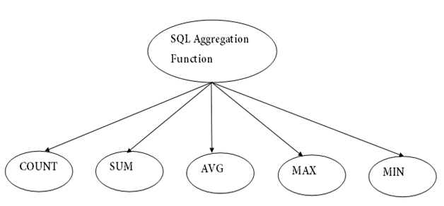
4.1 Types of Aggregate Functions
Types of SQL Aggregation Function

Slide 187
4.1.1 Count Function
1.COUNT FUNCTION
COUNT function is used to Count the number of rows in a database table. It can work on both numeric and non-numeric data types.
COUNT function uses the COUNT(*) that returns the count of all the rows in a specified table. COUNT(*) considers duplicate and Null.
Syntax:
COUNT(*)
or
COUNT( [ALL|DISTINCT] expression )

Slide 188
4.1.2 Count Function(Example)
Sample table:
PRODUCT_MAST
PRODUCT | COMPANY | QTY | RATE | COST
Item1 | Com1 | 2 | 10 | 20
Item2 | Com2 | 3 | 25 | 75
Item3 | Com1 | 2 | 30 | 60
Item4 | Com3 | 5 | 10 | 50
Item5 | Com2 | 2 | 20 | 40
Item6 | Cpm1 | 3 | 25 | 75
Item7 | Com1 | 5 | 30 | 150
Item8 | Com1 | 3 | 10 | 30
Item9 | Com2 | 2 | 25 | 50
Item10 | Com3 | 4 | 30 | 120

Slide 189
Count Function(Example)
Com1 5 Com2 3 Com3 2
Example: COUNT()
SELECT COUNT(*) FROM PRODUCT_MAST;
Output:
10
Example: COUNT with WHERE
SELECT COUNT(*) FROM PRODUCT_MAST; WHERE RATE>=20;
Output:
7
Example: COUNT() with DISTINCT
SELECT COUNT(DISTINCT COMPANY) FROM PRODUCT_MAST;
Output:
3
Example: COUNT() with GROUP BY
SELECT COMPANY, COUNT(*) FROM PRODUCT_MAST GROUP BY COMPANY;
Output:
Com1
Com2
Com3

Slide 190
4.1.3 SUM Function
Example: COUNT() with HAVING
SELECT COMPANY, COUNT(*)
FROM PRODUCT_MAST
GROUP BY COMPANY
HAVING COUNT(*)>2;
Output:
Com1 5
Com2 3
2. SUM Function
Sum function is used to calculate the sum of all selected columns. It works on numeric fields only.
Syntax:SUM()
or
SUM( [ALL|DISTINCT] expression )
Example: SUM()
SELECT SUM(COST)
FROM PRODUCT_MAST;

Slide 191
SUM Function(Example)
Example: SUM()
SELECT SUM(COST)
FROM PRODUCT_MAST;
Output:
670
Example: SUM() with WHERE
SELECT SUM(COST)
FROM PRODUCT_MAST
WHERE QTY>3;
Output:
320
Example: SUM() with GROUP BY
SELECT SUM(COST)
FROM PRODUCT_MAST
WHERE QTY>3
GROUP BY COMPANY;
Output:
Com1 150
Com2 170

Slide 192
4.1.4 AVG Function
Example: SUM() with HAVING
SELECT COMPANY, SUM(COST)
FROM PRODUCT_MAST
GROUP BY COMPANY
HAVING SUM(COST)>=170;
Output:
Com1 335
Com3 170
3. AVG function
The AVG function is used to calculate the average value of the numeric type. AVG function returns the average of all non-Null values.
Syntax
AVG()
or
AVG( [ALL|DISTINCT] expression )
Example:
SELECT AVG(COST)
FROM PRODUCT_MAST;
Output:
67.00

Slide 193
4.1.5 MAX Function
4. MAX Function
MAX function is used to find the maximum value of a certain column. This function determines the largest value of all selected values of a column.
Syntax
MAX()
or
MAX( [ALL|DISTINCT] expression )
Example:
SELECT MAX(RATE)
FROM PRODUCT_MAST;
30

Slide 194
4.1.6 MIN Function
5. MIN Function
MIN function is used to find the minimum value of a certain column. This function determines the smallest value of all selected values of a column.
Syntax
MIN()
or
MIN( [ALL|DISTINCT] expression )
Example:
SELECT MIN(RATE)
FROM PRODUCT_MAST;
Output:
10

Slide 195
Insert, Update and Delete Operations in SQL
The INSERT INTO statement is used to insert new records in a table.
It is possible to write the INSERT INTO statement in two ways.
Syntax
The first way specifies both the column names and the values to be inserted.
If you are adding values for all the columns of the table, then no need to specify the column names in the SQL query. However, make sure that the order of the values is in the same order as the columns in the table.
INSERT INTO table_name (column1, column2, column3, ...)
VALUES (value1, value2, value3, ...);
'2nd way
INSERT INTO table_name
VALUES (value1, value2, value3, ...);

Slide 196
5.1 INSERT operation Example
Example
Insert value in a 1st way. The column names are used here
INSERT INTO Employee (EmpId,LastName,FirstName,ADDRESS,City)
VALUES (1, 'XYZ', 'ABC', 'India', 'Mumbai' );
INSERT INTO Employee (EmpId,LastName,FirstName,ADDRESS,City)
VALUES (2, 'X', 'A', 'India', 'Pune' );
Insert value in a 2nd way.
INSERT INTO Employee
VALUES (3, 'XYZ', 'ABC', 'India', 'Mumbai' );

Slide 197
5.2 UPDATE Operation
Update Table :
The UPDATE statement is used to modify the existing records in a table.
Syntax
UPDATE table_name
SET column1 = value1, column2 = value2, ...
WHERE condition;
Example
UPDATE Employee
SET FirstName= 'KS', City= 'Pune'
WHERE EmpId= 1;

Slide 198
5.3 Delete operation
If the above query is executed then for EmpId= 1, "Firstname" and "City" column data will be updated.
Update Multiple Rows
It is the WHERE clause that determines how many records will be updated.
UPDATE Employee
SET City='Pune'
Delete in SQL
The DELETE statement is used to delete existing records in a table for a particular Record.
Syntax
DELETE FROM table_name WHERE condition;

Slide 199
Delete Operation(Example)
Example
DELETE FROM Employee WHERE EmpId=1;
In Employee table EmpId = 1 record gets deleted.
Delete All Records
It is possible to delete all rows in a table without deleting the table. This means that the table structure, attributes, and indexes will be intact,
DELETE FROM table_name;
DELETE From Employee ;
When the above query is executed, only table Data gets deleted.

Slide 200
6.SQL Joins
JOINS in SQL
Types of SQL joins
INNER JOIN
LEFT JOIN
RIGHT JOIN
FULL JOIN

Slide 201
Objective
To learn JOINS in SQL which helps to create and study relationships between tables.

Slide 202
6.1 SQL Join
As the name shows, JOIN means to combine something. In case of SQL, JOIN means "to combine two or more tables".
In SQL, JOIN clause is used to combine the records from two or more tables in a database.
Types of SQL JOIN
INNER JOIN
LEFT JOIN
RIGHT JOIN
FULL JOIN

Slide 203
SQL Joins
Sample Table
EMPLOYEE
PROJECT
EMP_ID | EMP_NAME | CITY | SALARY | AGE
1 | Angelina | Chicago | 200000 | 30
2 | Robert | Austin | 300000 | 26
3 | Christian | Denver | 100000 | 42
4 | Kristen | Washington | 500000 | 29
5 | Russell | Los angels | 200000 | 36
6 | Marry | Canada | 600000 | 48
ROJECT_NO | EMP_ID | DEPARTMENT
101 | 1 | Testing
102 | 2 | Development
103 | 3 | Designing
104 | 4 | Development

Slide 204

6.2.1 INNER Join
1. INNER JOIN
In SQL, INNER JOIN selects records that have matching values in both tables as long as the condition is satisfied. It returns the combination of all rows from both the tables where the condition satisfies.
Syntax
SELECT table1.column1, table1.column2, table2.column1,....
FROM table1
INNER JOIN table2
ON table1.matching_column = table2.matching_column;
Query
SELECT EMPLOYEE.EMP_NAME, PROJECT.DEPARTMENT
FROM EMPLOYEE
INNER JOIN PROJECT
ON PROJECT.EMP_ID = EMPLOYEE.EMP_ID;

Slide 205
6.2.2 LEFT Join
Output:
EMP_NAME | DEPARTMENT
Angelina | Testing
Robert | Development
Christian | Designing
Kristen | Development
2. LEFT JOIN
The SQL left join returns all the values from left table and the matching values from the right table. If there is no matching join value, it will return NULL.
Syntax
SELECT table1.column1, table1.column2, table2.column1,....
FROM table1
LEFT JOIN table2
ON table1.matching_column = table2.matching_column;

Slide 206
LEFT Join(Example)
Query
SELECT EMPLOYEE.EMP_NAME, PROJECT.DEPARTMENT
FROM EMPLOYEE
LEFT JOIN PROJECT
ON PROJECT.EMP_ID = EMPLOYEE.EMP_ID;
Output:
EMP_NAME | DEPARTMENT
Angelina | Testing
Robert | Development
Christian | Designing
Kristen | Development
Russell | NULL
Marry | NULL

Slide 207
6.2.3 RIGHT Join with Example
3. RIGHT JOIN
In SQL, RIGHT JOIN returns all the values from the values from the rows of right table and the matched values from the left table. If there is no matching in both tables, it will return NULL.
Syntax
SELECT table1.column1, table1.column2, table2.column1,....
FROM table1
RIGHT JOIN table2
ON table1.matching_column = table2.matching_column;
Query
SELECT EMPLOYEE.EMP_NAME, PROJECT.DEPARTMENT
FROM EMPLOYEE
RIGHT JOIN PROJECT
ON PROJECT.EMP_ID = EMPLOYEE.EMP_ID;

Slide 208
6.2.4 Full Join
Output:
EMP_NAME | DEPARTMENT
Angelina | Testing
Robert | Development
Christian | Designing
Kristen | Development
4. FULL JOIN
In SQL, FULL JOIN is the result of a combination of both left and right outer join. Join tables have all the records from both tables. It puts NULL on the place of matches not found.

Slide 209
Full Join Syntax
Syntax
SELECT table1.column1, table1.column2, table2.column1,....
FROM table1
FULL JOIN table2
ON table1.matching_column = table2.matching_column;
Query
SELECT EMPLOYEE.EMP_NAME, PROJECT.DEPARTMENT
FROM EMPLOYEE
FULL JOIN PROJECT
ON PROJECT.EMP_ID = EMPLOYEE.EMP_ID;

Slide 210
Full Join Example
Output
EMP_NAME | DEPARTMENT
Angelina | Testing
Robert | Development
Christian | Designing
Kristen | Development
Russell | NULL
Marry | NULL

Slide 211
7. SQL Union Operator
SQL Union Operator
The SQL Union Operator combines the result of two or more SELECT statements and provides the single output.
The data type and the number of columns must be the same for each SELECT statement used with the UNION operator. This operator does not show the duplicate records in the output table.
Syntax of UNION Set operator:
SELECT column1, column2 ...., columnN FROM table_Name1 [WHERE conditions]
UNION
SELECT column1, column2 ...., columnN FROM table_Name2 [WHERE conditions];

Slide 212
SQL Intersect Operator
SQL Intersect Operator
The SQL Intersect Operator shows the common record from two or more SELECT statements. The data type and the number of columns must be the same for each SELECT statement used with the INTERSECT operator.
Syntax of INTERSECT Set operator:
SELECT column1, column2 ...., columnN FROM table_Name1 [WHERE conditions]
INTERSECT
SELECT column1, column2 ...., columnN FROM table_Name2 [WHERE conditions];

Slide 213
SQL Minus Operator
SQL Minus Operator
The SQL Minus Operator combines the result of two or more SELECT statements and shows only the results from the first data set.
Syntax of MINUS operator:
SELECT column1, column2 ...., columnN FROM First_tablename [WHERE conditions]
MINUS
SELECT column1, column2 ...., columnN FROM Second_tablename [WHERE conditions];

Slide 214
PL/SQL Introduction
PL/SQL stands for "Procedural Language extensions to the Structured Query Language.“
PL/SQL is a block structured language that enables developers to combine the power of SQL with procedural statements.
All the statements of a block are passed to oracle engine all at once which increases processing speed and decreases the traffic.

Slide 215
Disadvantages of SQL:
SQL doesn’t provide the programmers with a technique of condition checking, looping and branching.
SQL statements are passed to Oracle engine one at a time which increases traffic and decreases speed.
SQL has no facility of error checking during manipulation of data.

Slide 216
Features of PL/SQL:
PL/SQL is basically a procedural language, which provides the procedure of decision making, iteration and many more features of procedural programming languages.
PL/SQL can execute a number of queries in one block using single command.
One can create a PL/SQL unit such as procedures, packages, triggers, and types, which are stored in the database for reuse by applications.
PL/SQL provides a feature to handle the exception which occurs in PL/SQL block known as exception handling block.
Applications written in PL/SQL are portable to computer hardware or operating system where Oracle is operational.
PL/SQL offers extensive error checking.

Slide 217
Differences between SQL and PL/SQL
SQL | PL/SQL
SQL is a single query that is used to perform DML and DDL operations. | PL/SQL is a block of codes that used to write the entire program blocks/ procedure, etc.
It is declarative, that defines what needs to be done, rather than how things need to be done. | PL/SQL is procedural that defines how the things needs to be done.
Execute as a single statement. | Execute as a whole block.
Mainly used to manipulate data. | Mainly used to create an application.
Cannot contain PL/SQL code in it. | It is an extension of SQL, so it can contain SQL inside it.

Slide 218
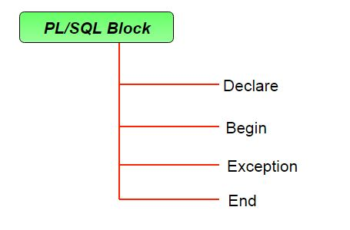
Structure of PL/SQL Block:
The basic unit in PL/SQL is a block.
All PL/SQL programs are made up of blocks, which can be nested within each other.
DECLARE
declaration statements;
BEGIN
executable statements
EXCEPTIONS
exceptionhandling statements
END;

Slide 219
PL/SQL identifiers
There are several PL/SQL identifiers such as variables, constants, procedures, cursors, triggers etc.
Variables:
Like several other programming languages, variables in PL/SQL must be declared prior to its use.
They should have a valid name and data type as well.
Syntax for declaration of variables:
variable_name datatype [NOT NULL := value ];

Slide 220
PL/SQL
SQL> SET SERVEROUTPUT ON;
SQL> DECLARE
var1 INTEGER;
var2 REAL;
var3 varchar2(20) ;
BEGIN
null;
END;
/
/*SET SERVEROUTPUT ON: It is used to display the buffer used by the dbms_output. */
--declaration of variable, named var1 which is of integer type.

Slide 221
PL/SQL Example
SQL> SET SERVEROUTPUT ON;
SQL> DECLARE
-- I am a comment, so i will be ignored.
var varchar2(40) := 'I love INDIA' ;
BEGIN
dbms_output.put_line(var);
END;
/
dbms_output.put_line : This command is used to direct the PL/SQL output to a screen.
Output:
I love INDIA
PL/SQL procedure successfully completed.

Slide 222
PL/SQL Example
PL/SQL code to print sum of two numbers taken from the user.
declare -- declare variable x, y -- and z of datatype number x number(5); y number(5); z number(7); begin -- Here we Assigning 10 into x x:=10; -- Assigning 20 into x y:=20; -- Assigning sum of x and y into z z:=x+y; -- Print the Result dbms_output.put_line('Sum is '||z); end; / -- Program End

Slide 223
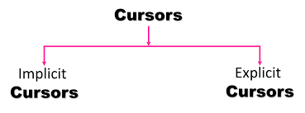
PL/SQL – Cursors
Oracle creates a memory area, known as the context area, for processing an SQL statement, which contains all the information needed for processing the statement.
cursor is a pointer to this context area.
PL/SQL controls the context area through a cursor.
A cursor holds the rows (one or more) returned by a SQL statement.
The set of rows the cursor holds is referred to as the active set.
There are two types of cursors −
Implicit cursors
Explicit cursors

Slide 224
Implicit Cursors
Implicit cursors are automatically created by Oracle whenever an SQL statement is executed.
Programmers cannot control the implicit cursors and the information in it.
Whenever a DML statement (INSERT, UPDATE and DELETE) is issued, an implicit cursor is associated with this statement.
For INSERT operations, the cursor holds the data that needs to be inserted.
For UPDATE and DELETE operations, the cursor identifies the rows that would be affected.

Slide 225
Attributes of SQL CURSOR
For DML STATEMENT or SELECT statement
%FOUND
Returns TRUE if an INSERT, UPDATE, or DELETE statement affected one or more rows or a SELECT statement returned one or more rows. Otherwise, it returns FALSE.
The logical opposite of %FOUND.
It returns TRUE if an INSERT, UPDATE, or DELETE statement affected no rows, or a SELECT statement returned no rows. Otherwise, it returns FALSE.
%NOTFOUND
%ISOPEN
Always returns FALSE for implicit cursors, because Oracle closes the SQL cursor automatically after executing its associated SQL statement. Returns TRUE for explicit cursor if it is open
%ROWCOUNT
Returns the number of rows affected by an INSERT, UPDATE, or DELETE statement, or returned by a SELECT statement.

Slide 226
PL/SQL –Implicit Cursor Example
Customers
ID | NAME | AGE | ADDRESS | SALARY | +----+----------+-----+-----------+---------- | 1 | Ramesh | 32 | Ahmedabad | 2000.00 |
| 2 | Khilan | 25 | Delhi | 1500.00 |
| 3 | kaushik | 23 | Kota | 2000.00 |
| 4 | Chaitali | 25 | Mumbai | 6500.00 |
| 5 | Hardik | 27 | Bhopal | 8500.00 |
| 6 | Komal | 22 | MP | 4500.00 |

Slide 227
PL/SQL –Implicit Cursor Example
update the table and increase the salary of each employee by 500 and use the SQL%ROWCOUNT attribute to determine the number of rows affected
DECLARE
total_rows number(2);
BEGIN
UPDATE employee1
SET salary = salary + 500
Where age<=25;
IF sql%notfound
THEN
dbms_output.put_line('no customers selected’);
ELSIF sql%found
THEN total_rows := sql%rowcount;
dbms_output.put_line( total_rows||'customers selected’);
END IF;
END;
/

Slide 228
PL/SQL –Implicit Cursor Output
update the table and increase the salary of each employee by 500 and use the SQL%ROWCOUNT attribute to determine the number of rows affected
6 customers selected
PL/SQL procedure successfully completed.
Select * from customers;
ID | NAME | AGE | ADDRESS | SALARY | +----+----------+-----+-----------+----------| 1 | Ramesh | 32 | Ahmedabad | 2500.00 |
| 2 | Khilan | 25 | Delhi | 2000.00 |
| 3 | kaushik | 23 | Kota | 2500.00 |
| 4 | Chaitali | 25 | Mumbai | 7000.00 |
| 5 | Hardik | 27 | Bhopal | 9000.00 |
| 6 | Komal | 22 | MP | 5000.00 | +----+----------+-----+-----------+----------+

Slide 229
Explicit Cursors
Explicit cursors are programmer-defined cursors for gaining more control over the context area.
An explicit cursor should be defined in the declaration section of the PL/SQL Block.
It is created on a SELECT Statement which returns more than one row.
CURSOR cursor_name IS select_statement;

Slide 230
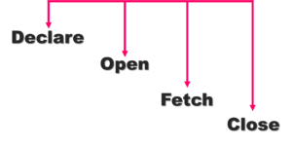
Steps involved with explicit cursor
Declaring the cursor for initializing the memory
CURSOR cursor_name IS select_statement;
Opening the cursor for allocating the memory
OPEN cursor_name;
Fetching the cursor for retrieving the data
FETCH cursor_name INTO PL/SQL variable;
Or
FETCH cursor_name INTO PL/SQL record;
Closing the cursor to release the allocated memory
CLOSE cursor_name;

Slide 231
Explicit Cursors(Example)
DECLARE
OPEN
FETCH (in loop)
End of loop
CLOSE
DECLARE
Cursor c1 is
SELECT empno, ename from emp;
v_empno emp.empno%Type;
V_ename emp.ename%Type;
BEGIN
OPEN c1;
LOOP
FETCH c1 into v_empno, v_name;
EXIT WHEN c1%notfound;
dbms_output.put_line(v_empno || ' ' || v_ename);
END LOOP;
CLOSE c1;
END;

Slide 232
Explicit Cursors(Example)
DECLARE
c_id customers.id%type;
c_name customers.name%type;
c_addr customers.address%type;
CURSOR c_customers is
SELECT id, name, address FROM customers;
BEGIN
OPEN c_customers;
LOOP
FETCH c_customers into c_id, c_name, c_addr;
EXIT WHEN c_customers%notfound;
dbms_output.put_line(c_id || ' ' || c_name || ' ' || c_addr);
END LOOP;
CLOSE c_customers;
END;

Slide 233
Explicit Cursors: Output
1 Ramesh Ahmedabad
2 Khilan Delhi
3 kaushik Kota
4 Chaitali Mumbai
5 Hardik Bhopal
6 Komal MP
PL/SQL procedure successfully completed.

Slide 234
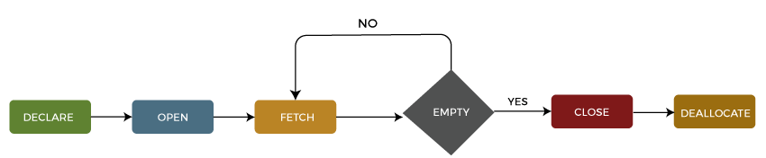
8.2 Life Cycle of Cursor
Life Cycle of the cursor
We can describe the life cycle of a cursor into the five different sections as follows:

Slide 235
9. Trigger
Triggers are stored programs, which are automatically executed or fired when some events occur. Triggers are, in fact, written to be executed in response to any of the following events −
A database manipulation (DML) statement (DELETE, INSERT, or UPDATE)
A database definition (DDL) statement (CREATE, ALTER, or DROP).
A database operation (SERVERERROR, LOGON, LOGOFF, STARTUP, or SHUTDOWN).
Triggers can be defined on the table, view, schema, or database with which the event is associated.
Benefits of Triggers
Generating some derived column values automatically
Enforcing referential integrity
Event logging and storing information on table access
Auditing
Synchronous replication of tables
Imposing security authorizations
Preventing invalid transactions

Slide 236
Creating Trigger
CREATE [OR REPLACE ] TRIGGER trigger_name
{BEFORE | AFTER | INSTEAD OF }
{INSERT [OR] | UPDATE [OR] | DELETE}
[OF col_name]
ON table_name
[REFERENCING OLD AS o NEW AS n]
[FOR EACH ROW]
WHEN (condition)
DECLARE
Declaration-statements
BEGIN
Executable-statements
EXCEPTION
Exception-handling-statements
END;

Slide 237
Creating Trigger
CREATE [OR REPLACE] TRIGGER trigger_name − Creates or replaces an existing trigger with the trigger_name.
{BEFORE | AFTER | INSTEAD OF} − This specifies when the trigger will be executed. The INSTEAD OF clause is used for creating trigger on a view.
{INSERT [OR] | UPDATE [OR] | DELETE} − This specifies the DML operation.
[OF col_name] − This specifies the column name that will be updated.
[ON table_name] − This specifies the name of the table associated with the trigger.
[REFERENCING OLD AS o NEW AS n] − This allows you to refer new and old values for various DML statements, such as INSERT, UPDATE, and DELETE.
[FOR EACH ROW] − This specifies a row-level trigger, i.e., the trigger will be executed for each row being affected. Otherwise the trigger will execute just once when the SQL statement is executed, which is called a table level trigger.
WHEN (condition) − This provides a condition for rows for which the trigger would fire. This clause is valid only for row-level triggers.

Slide 238
Creating a trigger(Cont.)
OLD and NEW references are not available for table-level triggers, rather you can use them for record-level triggers.
If you want to query the table in the same trigger, then you should use the AFTER keyword, because triggers can query the table or change it again only after the initial changes are applied and the table is back in a consistent state.
The above trigger has been written in such a way that it will fire before any DELETE or INSERT or UPDATE operation on the table, but you can write your trigger on a single or multiple operations, for example BEFORE DELETE, which will fire whenever a record will be deleted using the DELETE operation on the table.

Slide 239
Row-Level Trigger: Example
Creating backup of customer’s salary on deletion of customer table
CREATE OR REPLACE TRIGGER salary_changes
BEFORE DELETE ON customers
FOR EACH ROW
WHEN (NEW.ID > 0)
BEGIN
Insert into backup values(:old.salary);
END;
To check the trigger delete one row from customer table:
Delete from customer where id=1;
Select * from customer
Select * from salary_changes

Slide 240
Row-Level Trigger: Example
CREATE OR REPLACE TRIGGER display_salary_changes
BEFORE DELETE OR INSERT OR UPDATE ON customers
FOR EACH ROW
WHEN (NEW.ID > 0)
DECLARE
sal_diff number;
BEGIN
sal_diff := :NEW.salary - :OLD.salary;
dbms_output.put_line('Old salary: ' || :OLD.salary); dbms_output.put_line('New salary: ' || :NEW.salary); dbms_output.put_line('Salary difference: ' || sal_diff);
END;

Slide 241
Triggering a Trigger
INSERT INTO CUSTOMERS (ID,NAME,AGE,ADDRESS,SALARY) VALUES (7, 'Kriti', 22, 'HP', 7500.00 );
When a record is created in the CUSTOMERS table, the above create trigger, display_salary_changes will be fired and it will display the following result −
Old salary:
New salary: 7500
Salary difference:
UPDATE customers SET salary = salary + 500 WHERE id = 2;
When a record is updated in the CUSTOMERS table, the above create trigger, display_salary_changes will be fired and it will display the following result −
Old salary: 1500
New salary: 2000
Salary difference: 500

Slide 242
10. Procedures in SQL/PL SQL
Used for repeated execution.
PL/SQL is a block-structured language that enables developers to combine the power of SQL with procedural statements. A stored procedure in PL/SQL is nothing but a series of declarative SQL statements which can be stored in the database catalogue.
A procedure can be thought of as a function or a method. They can be invoked through triggers, other procedures, or applications on Java, PHP etc. All the statements of a block are passed to Oracle engine all at once which increases processing speed and decreases the traffic.

Slide 243
10.1 Advantages of Procedures
Advantages:
They result in performance improvement of the application. If a procedure is being called frequently in an application in a single connection, then the compiled version of the procedure is delivered.
They reduce the traffic between the database and the application, since the lengthy statements are already fed into the database and need not be sent again and again via the application.
They add to code reusability, similar to how functions and methods work in other languages such as C/C++ and Java.

Slide 244
10.2 Disadvantages of Procedures
Disadvantages:
Stored procedures can cause a lot of memory usage. The database administrator should decide an upper bound as to how many stored procedures are feasible for a particular application.
MySQL does not provide the functionality of debugging the stored procedures.

Slide 245
10.3 Syntax for Procedure
Syntax to create a procedure
CREATE PROCEDURE procedure_name AS sql_statement GO;
Execute a Stored Procedure
EXEC procedure_name;

Slide 246
10.3 Syntax for Procedure
DECLARE
a number; b number; c number; PROCEDURE findMin(x IN number, y IN number, z OUT number) IS
BEGIN IF x < y THEN
z:= x;
ELSE
z:= y;
END IF; END;
BEGIN a:= 23;
b:= 45;
findMin(a, b, c);
dbms_output.put_line(' Minimum of (23, 45) : ' || c);
END;

Slide 247
Daily Quiz
1. The ___________ operation, denoted by −, allows us to find tuples that are in one relation but are not in another.
Union
Set-difference
Difference
Intersection
2. Which is a join condition contains an equality operator:
Equijoins
Cartesian
Natural
Left
3. Relational Algebra is a __________ query language that takes two relations as input and produces another relation as an output of the
Relational
Structural
Procedural
Fundamental

Slide 248
Daily Quiz
4. ________________ is not a category of SQL.
TCL
SCL
DDL
DCL
5. Which of the following SQL clauses is used to DELETE tuples from a database
table?
DELETE
REMOVE
DROP
CLEAR
6. Which SQL keyword is used to retrieve a maximum value?
MOST
TOP
MAX
UPPER

Slide 249
MCQ s
1. Which of the following in true regarding Referential Integrity?
Every primary-key value must match a primary-key value in an associated table
Every primary-key value must match a foreign-key value in an associated table
Every foreign-key value must match a primary-key value in an associated table
Every foreign-key value must match a foreign-key value in an associated table
2. Which of the following is used to denote the selection operation in relational algebra ?
Pi (Greek)
Sigma (Greek)
Lambda (Greek)
Omega (Greek)

Slide 250
MCQ s
3. In precedence of set operators the expression is evaluated from
Left to right
Right to left
From user specification
None
4.Data Manipulation Language (DML) is not to
Create information table in the Database
Insertion of new information into the Database
Deletion of information in the Database
Modification of information in the Database

Slide 251
MCQ s
5. Which SQL function is used to count the number of rows in a SQLquery?
a)COUNT()
b)NUMBER()
c)SUM()
d) COUNT(*)
6.What is the purpose of the SQL AS clause? a) The AS SQL clause is used to change the name of a column in the result set or to assign a name to a derived column b) The AS clause is used with the JOIN clause only c) The AS clause defines a search condition d) All of the mentioned

Slide 252
MCQs
7.Which statement is true regarding procedures?
They include procedural and SQL statements.
They work similarly to the functions.
It does not need unique names.
It cannot be created with SQL statements.
8.Which of the following is the correct order of a SQL statement?
SELECT, GROUP BY, WHERE, HAVING
SELECT, WHERE, GROUP BY, HAVING
SELECT, HAVING, WHERE, GROUP BY
SELECT, WHERE, HAVING, GROUP BY

Slide 253
Glossary Questions
Choose the correct option:
____________ is an Instance of a Database.
2. ___________ is the work of “x” operator in relational algebra.
3.A valid aggregate function is __________.
4.The command which is used to change the definition of a table in SQL is ________.
Sum
Output all pairs of rows from the two input relations (regardless of whether or not they have the same values on common attributes)
The state of the database system at any given point of time.
Alter

Slide 254
Weekly Assignment
Explain Entity integrity and Referential integrity in detail. CO2
What is relational algebra? Discuss the various operations of relational algebra with suitable example. CO2
What is relational calculus? Differentiate relational algebra and relational calculus. CO2
What is the difference between DBMS and RDBMS? Which of them is more suitable? CO2
Why are integrity constraints important in database? CO2
Discuss about SQL and it’s advantages. CO2
Explain stored procedure and stored function with example. CO2

Slide 255
Old Question Papers
http://www.aktuonline.com/papers/btech-cs-5-sem-data-base-management-system-rcs501-2020.pdf
http://www.aktuonline.com/papers/btech-cs-5-sem-database-management-system-KCS501-2018-19.pdf
http://www.aktuonline.com/papers/btech-cs-5-sem-database-management-system-ncs-502-2017-18.pdf
http://www.aktuonline.com/papers/btech-cs-5-sem-database-management-system-ncs-502-2016-17.pdf

Slide 256
Expected Questions for University Exam
What is Relational Algebra?
Describe Integrity constraints with its types.
Discuss the following terms (i) DDL Command (ii) DML command.
Write difference between Cross Join, Natural Join, left outer join and right outer join with suitable example.
Define constraint and its types in DBMS.
What is relational calculus? Differentiate relational algebra and relational calculus.
List the data types that are allowed for SQL Attributes.
What do you mean by Cursors in SQL?
Define Union and Intersection using SQL.

Slide 257
Expected Questions for University Exam
Give the following queries in the relational algebra using the relational schema:
student(id, name)
enrolled(id, code)
subject(code, lecturer)
i). What are the names of students enrolled in cs3020?
ii). Which subjects is Hector taking?
iii). Who teaches cs1500?
iv). Who teaches cs1500 or cs3020?
v). Who teaches at least two different subjects?
vi). What are the names of students in cs1500 or cs307?
vii). What are the names of students in both cs1500 and cs1200?

Slide 258
Recap of Unit
Knowledge of relational data model and language.
Knowledge of SQL and SQL Commands.
Knowledge of handling queries in DBMS
Knowledge of Cursors and Procedures

Slide 259
Faculty Video Links, You tube & NPTEL Video Links and Online Courses Details
Video Links:
https://www.youtube.com/watch?v=kBdlM6hNDAE&list=PLxCzCOWd7aiFAN6I8CuViBuCdJgiOkT2Y
https://www.youtube.com/watch?v=AepLj_C4ywM
https://www.youtube.com/watch?v=zYH-e6tUYbw
https://www.youtube.com/watch?v=hIh5-Y1QwFw
https://www.youtube.com/watch?v=OuFJzs1hGxM

Slide 260
References
Korth, Silbertz, Sudarshan,” Database Concepts”, McGraw Hill
Date C J, “An Introduction to Database Systems”, Addision Wesley
Elmasri, Navathe, “ Fundamentals of Database Systems”, Addision Wesley
O’Neil, Databases, Elsevier Pub.
RAMAKRISHNAN"Database Management Systems",McGraw Hill
Leon &Leon,”Database Management Systems”, Vikas Publishing House
Bipin C. Desai, “ An Introduction to Database Systems”, Galgotia Publications
Majumdar& Bhattacharya, “Database Management System”, TMH
R.P. Mahapatra, Database Management System, Khanna Publishing House

Slide 261
Thank You

